Slide 1
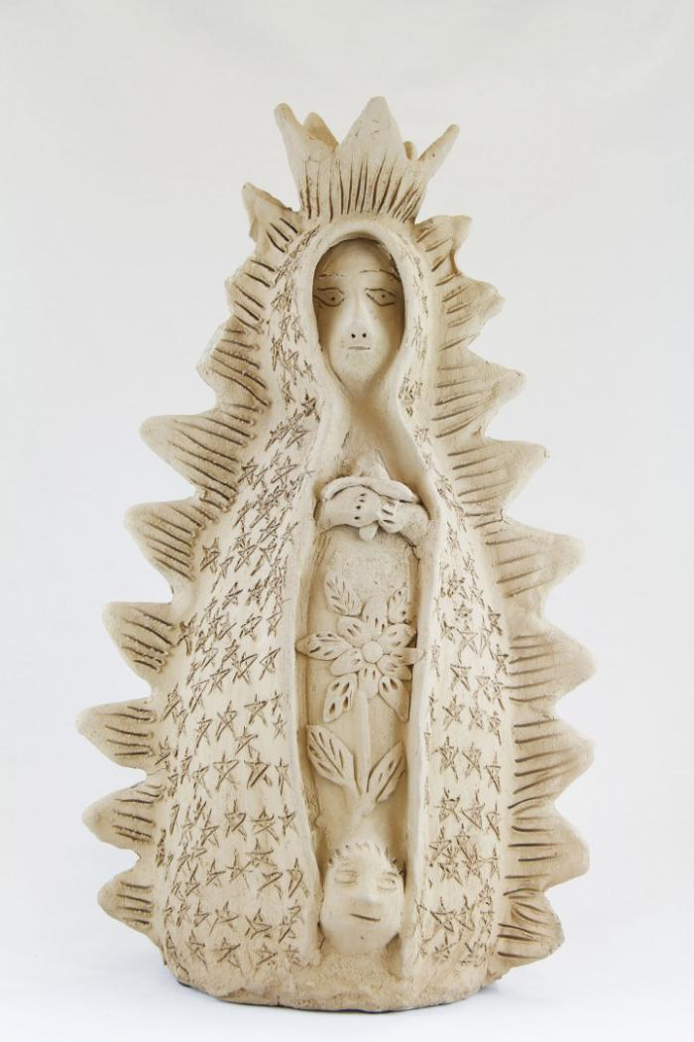
Virgen de Guadalupe (M1031)

Slide 2
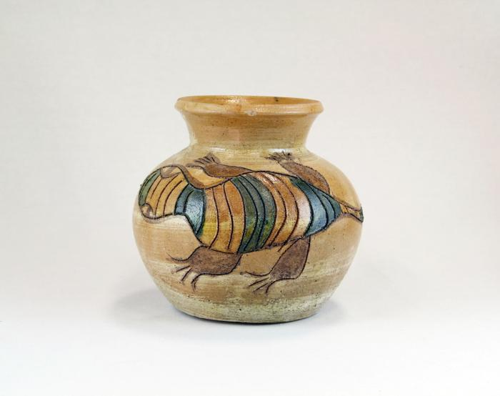
Tan Clay Pot with Lizards (M1032)

