Slide 1
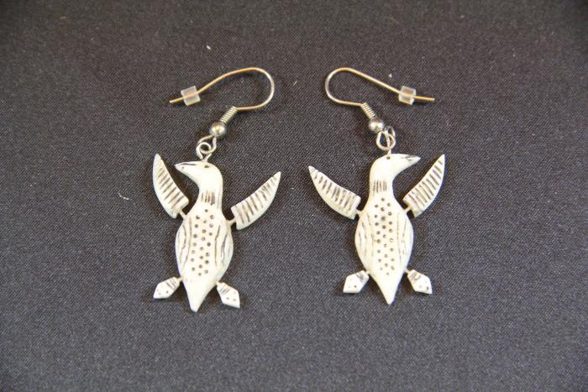
Loon Birds Earrings (AC10)

