Slide 1
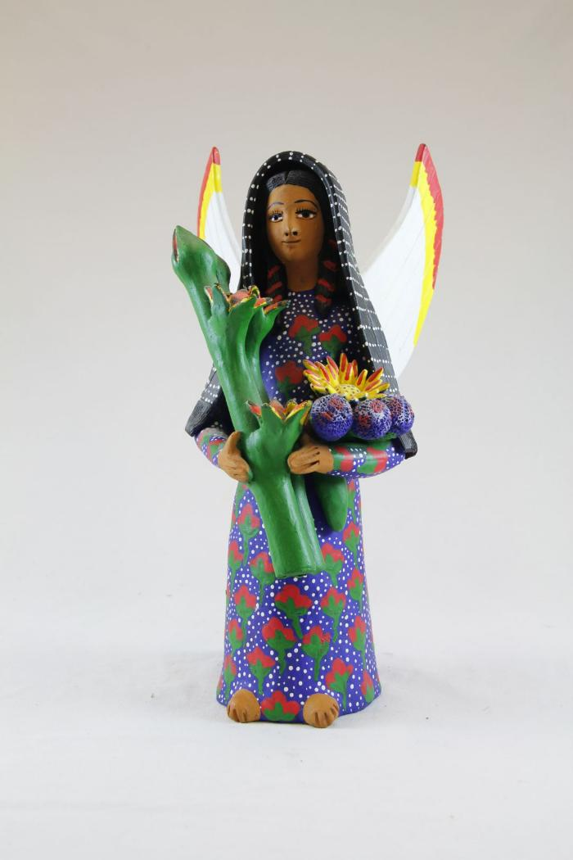
Angel holding Flowers (SH9)

