Slide 1
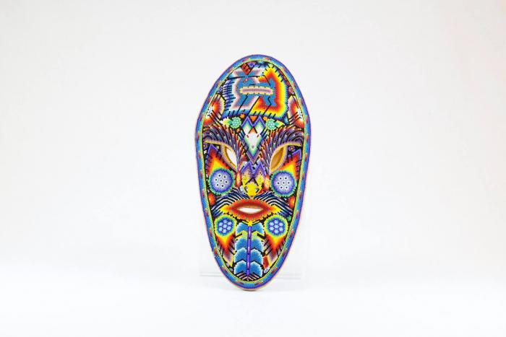
Huichol mask (CA23)

