Slide 1
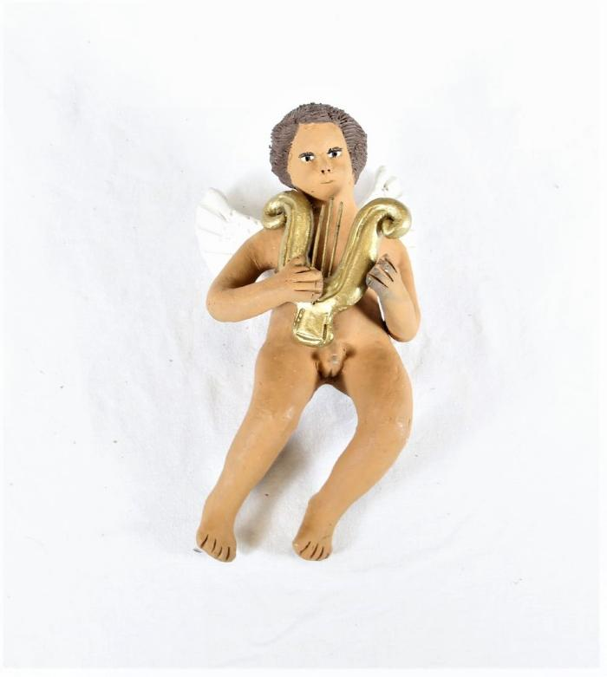
Boy Angel playing Harp (SH37)

