Slide 1
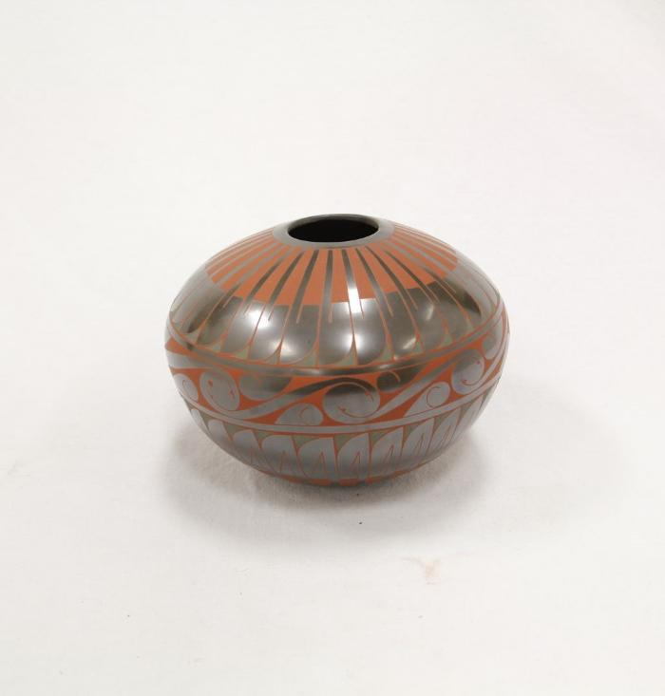
Black Green and Red Vase (SH24)

Slide 2
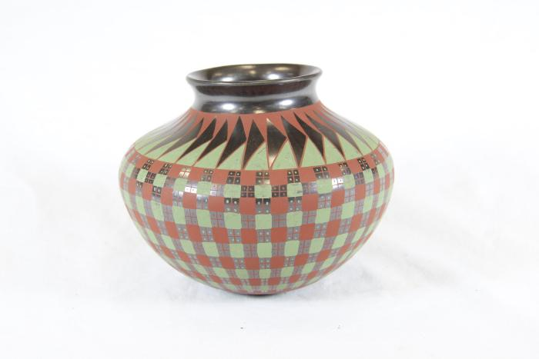
Red Green and Silver Vase (SH103)

