Slide 1
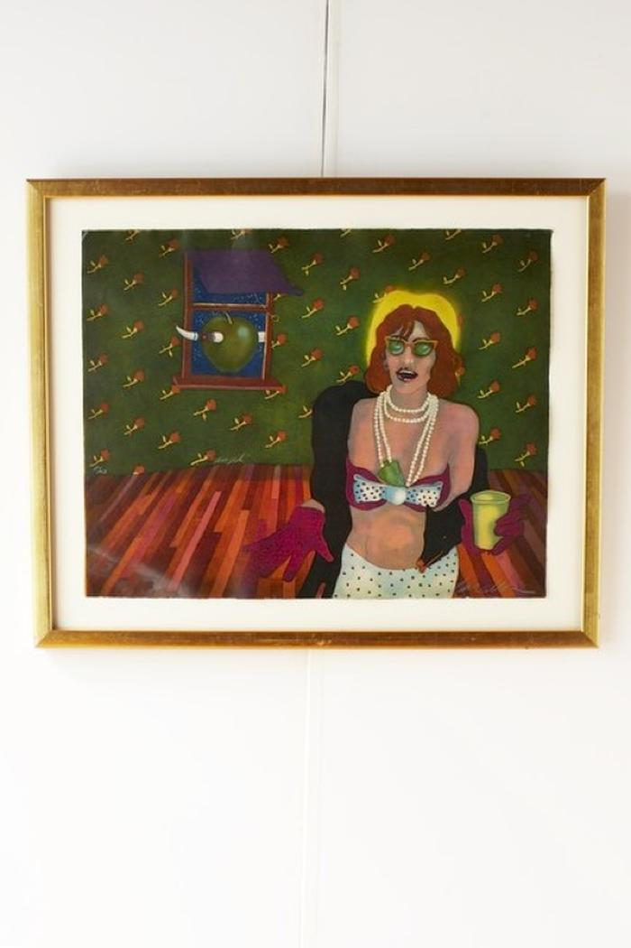
Angel Etching (FRA1)

Slide 2
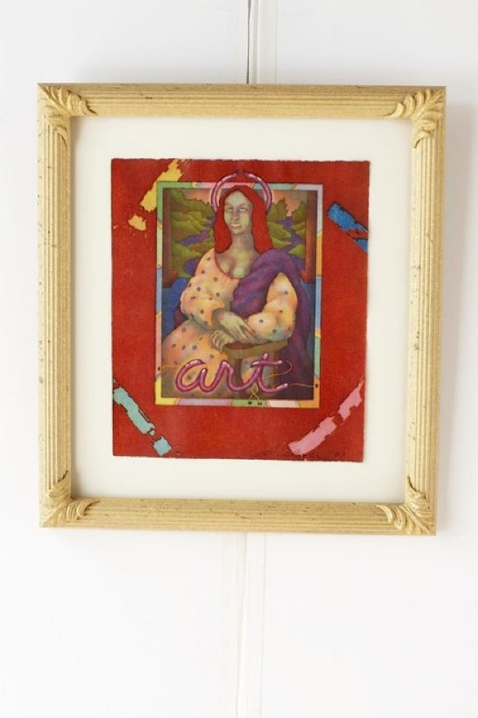
Mona Lisa (FRA2)

Slide 3
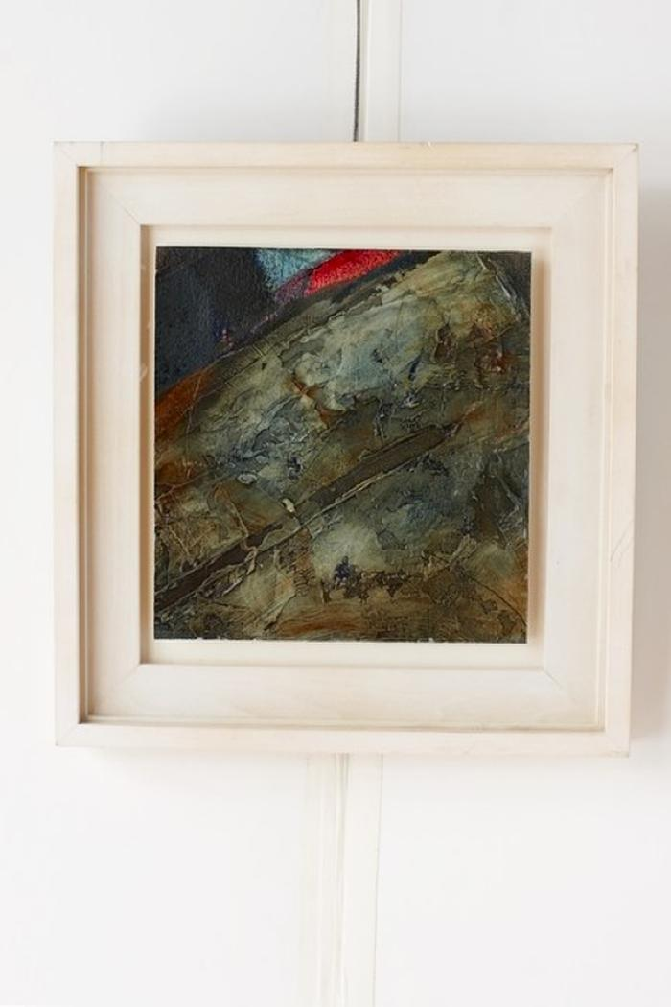
Blue Planet (FRA3)

Slide 4
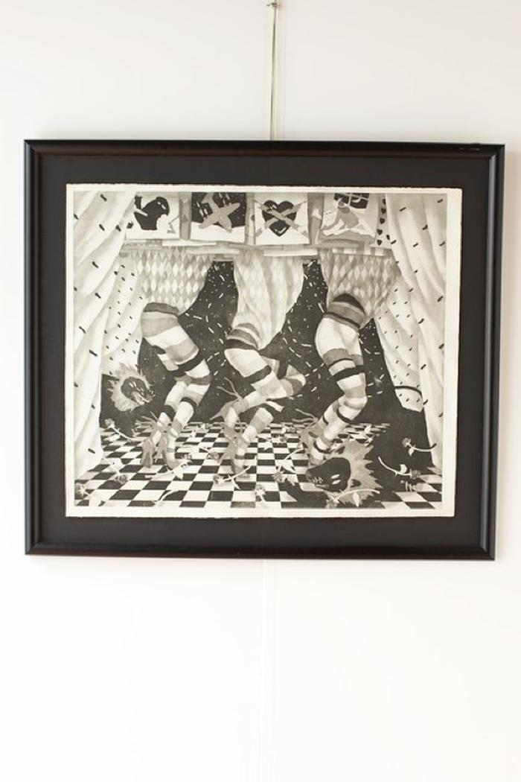
Dancing in the Shadows (FRA4)

Slide 5
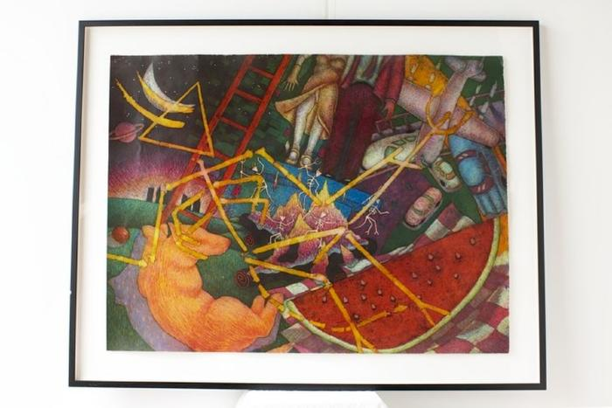
Huf der Kanter on the Edge (FRA5)

Slide 6
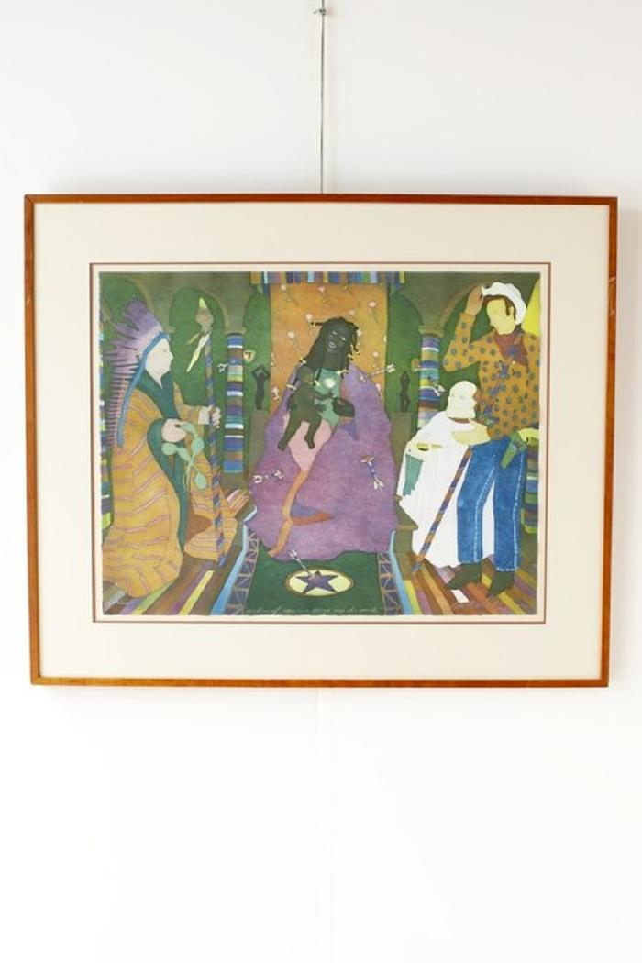
Madonna of the Canon George Vander Pale, Dan Allison (FRA6)

Slide 7
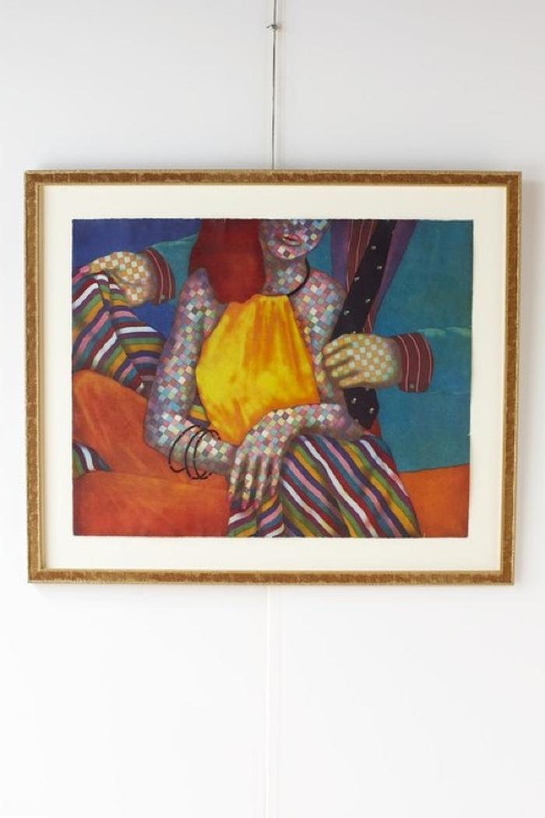
Checkered Woman and Man (FRA7)

