Slide 1
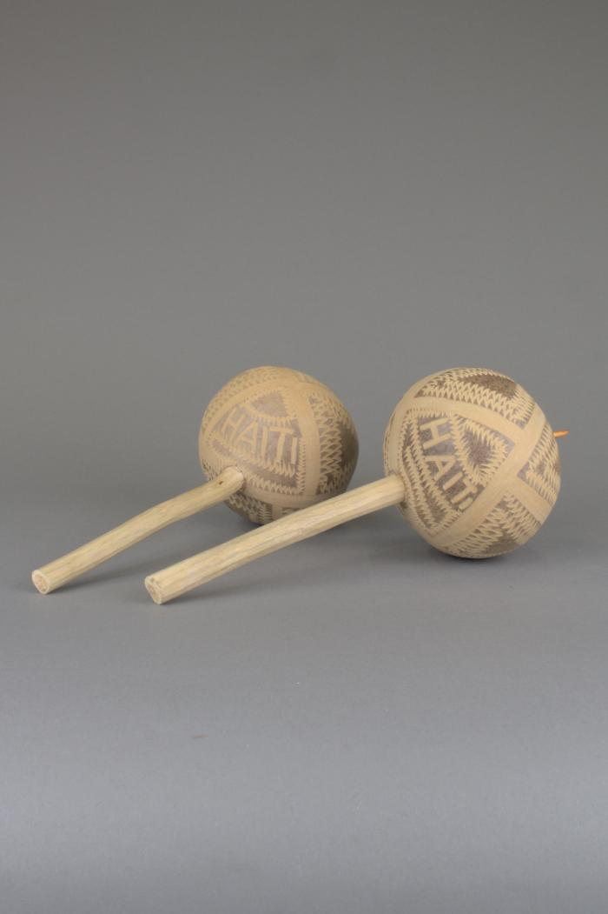
Calabash Gourd Shakers (FR52)

Slide 2
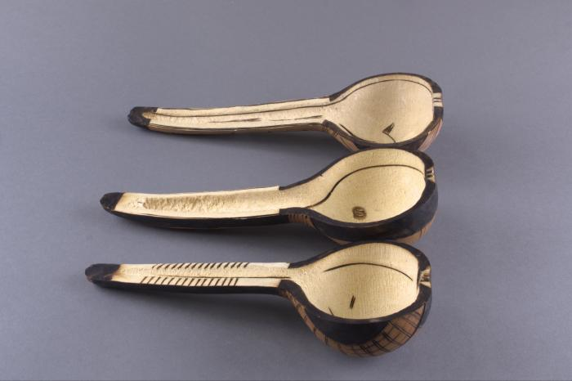
Ludayi (Carved Calabash Gourd Ladles) (FR159)

