Slide 1
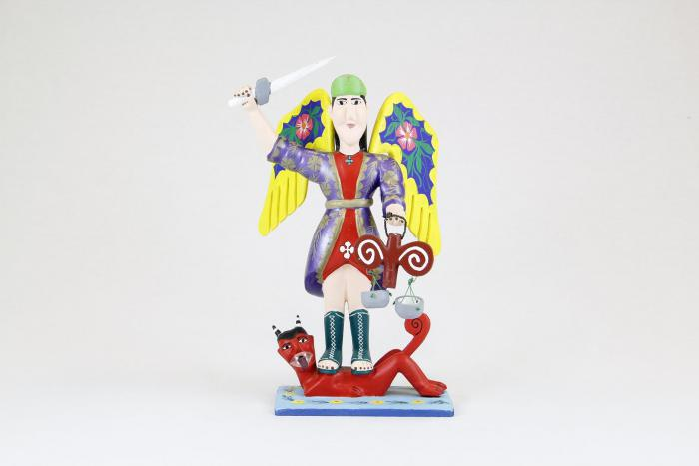
St. Michael with wings, sword and scales (CA2)

Slide 2
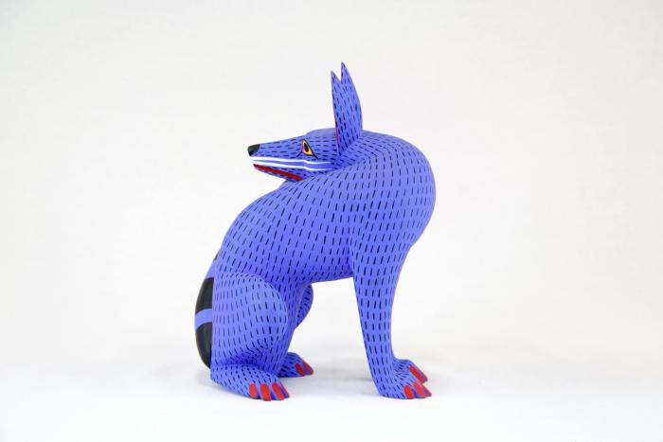
Coyote (CA3)

Slide 3
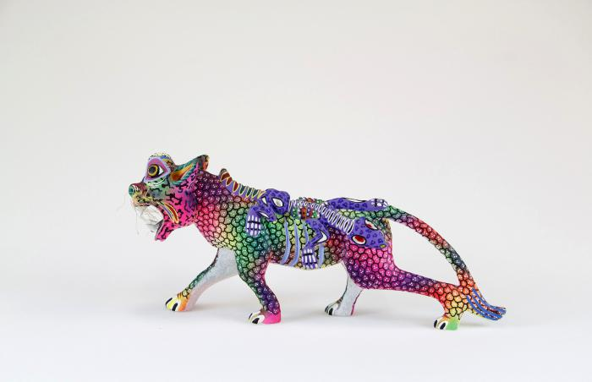
Whiskered jaguar with lizard (CA6)

Slide 4
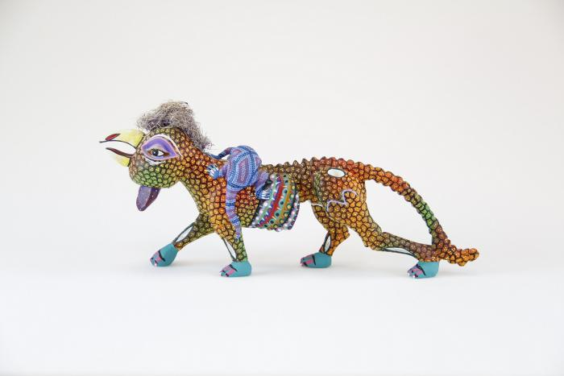
Rooster headed jaguar with lizard (CA7)

Slide 5
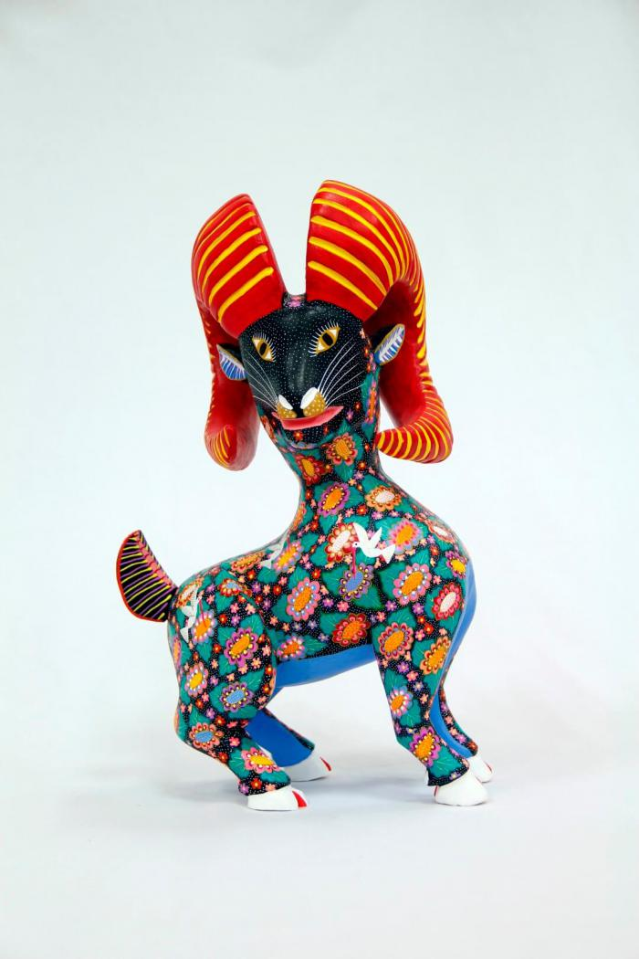
Horned goat (CA8)

Slide 6
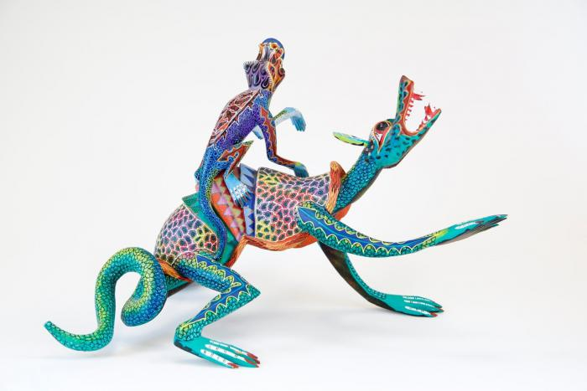
Two lizards (CA9)

Slide 7
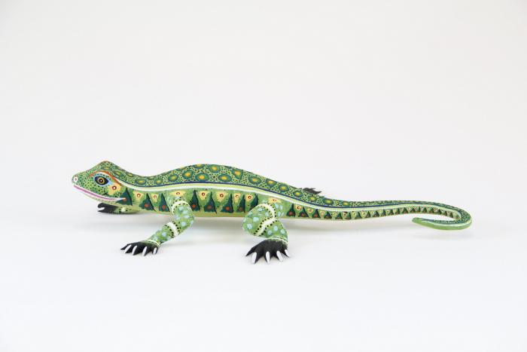
Lizard (CA10)

Slide 8
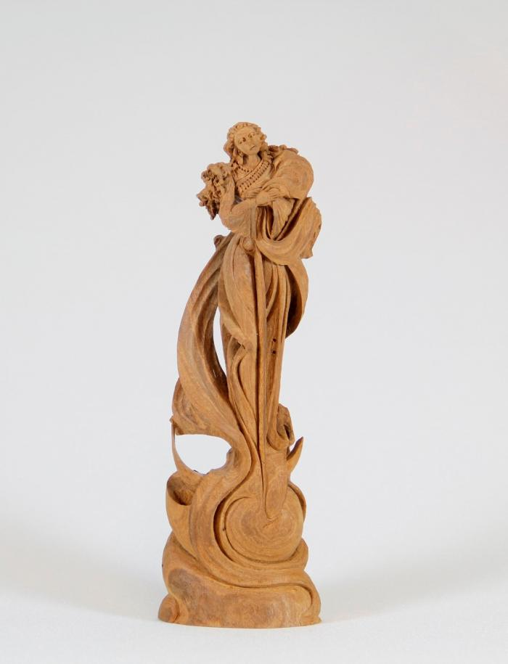
Angel (CA11)

Slide 9
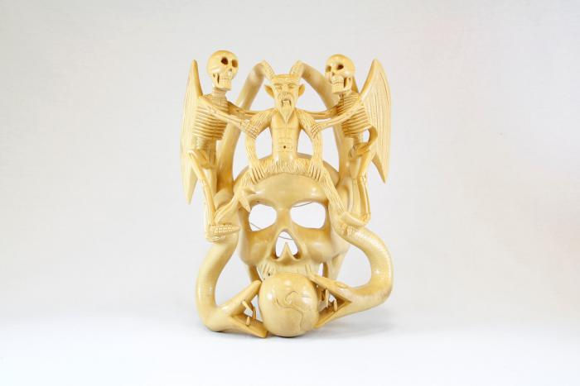
Skull mask (CA13)

Slide 10
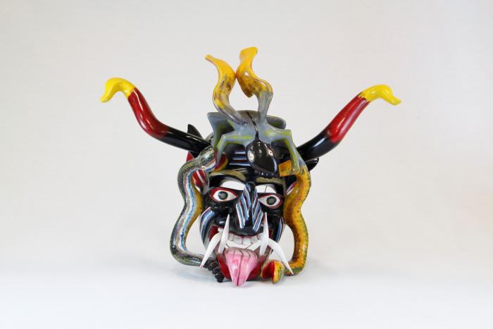
Devil mask with 2 snakes, horns (CA14)

Slide 11
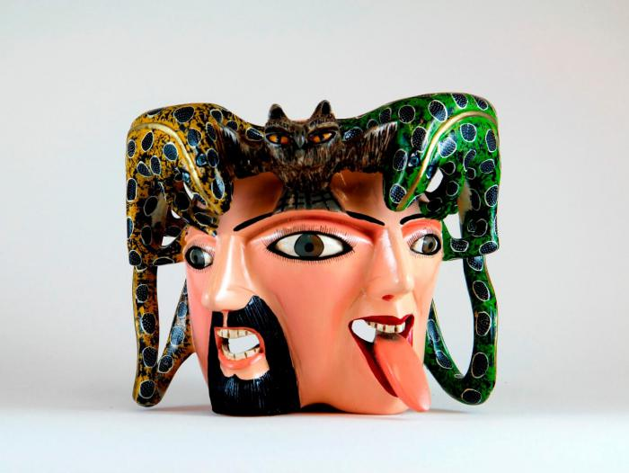
Male / female mask owl and lizards on top (CA15)

Slide 12
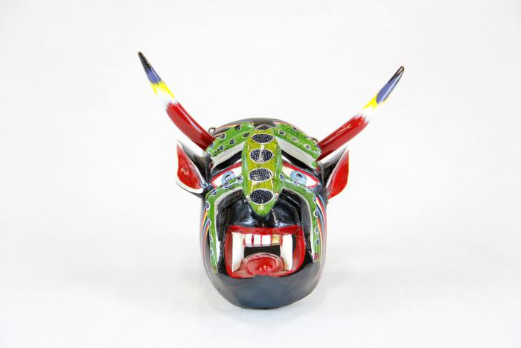
Small devil mask with green lizard (CA17)

Slide 13
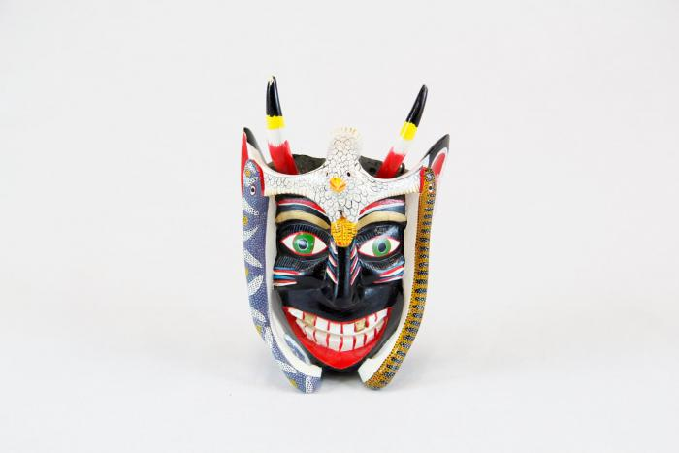
Small black devil mask with bird (CA18)

Slide 14
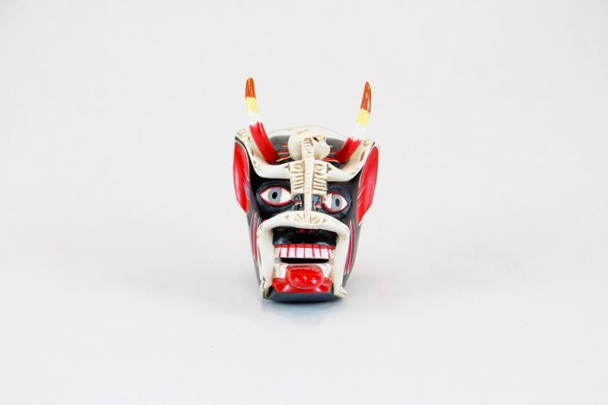
Small devil mask with skeleton (CA19)

Slide 15
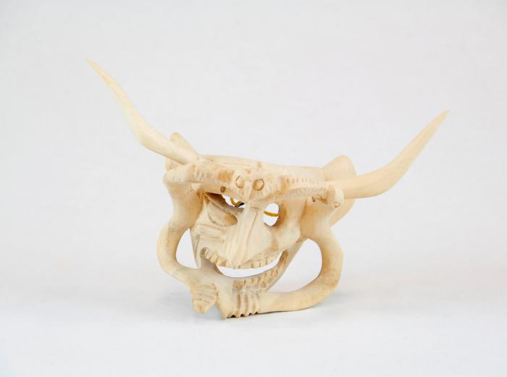
Devil Mask w/ two serpents and owl (CA24)

Slide 16
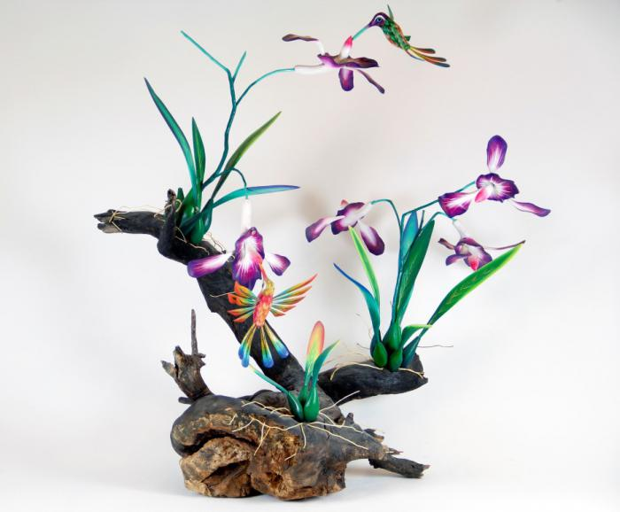
Orchid and Hummingbirds on driftwood base (CA26)

Slide 17
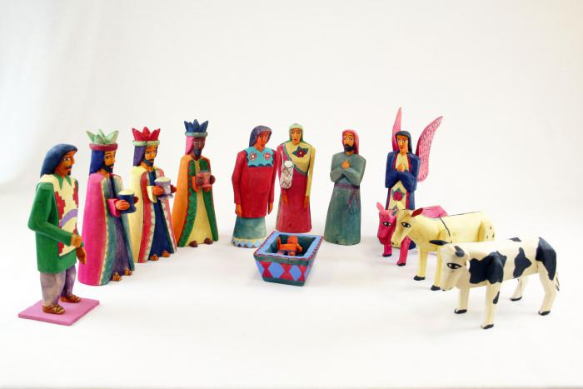
Dyed Wood Nativity (12 pieces) (M1037)

Slide 18
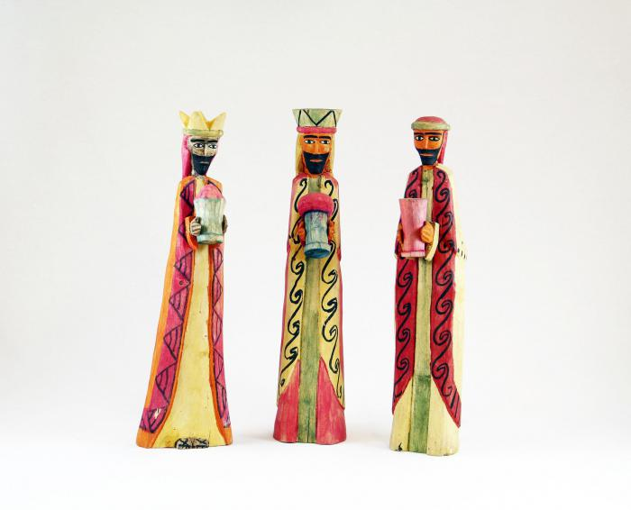
Wisemen Standing (3 pieces) (M1038)

Slide 19
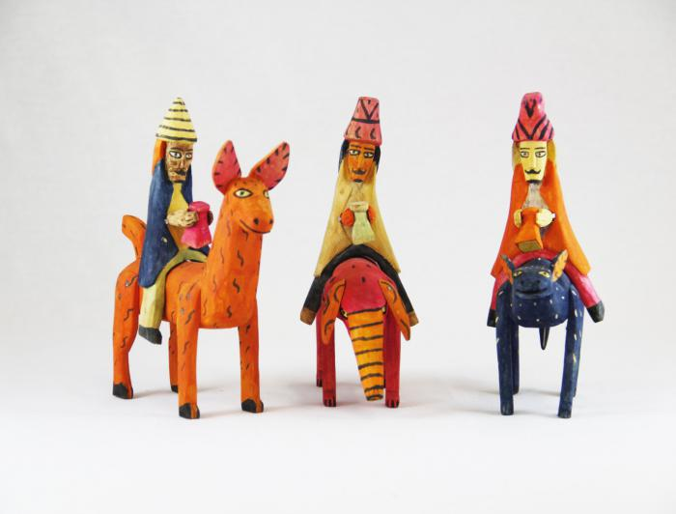
Three Wood Carved Wiseman riding on Animals (M1039)

Slide 20
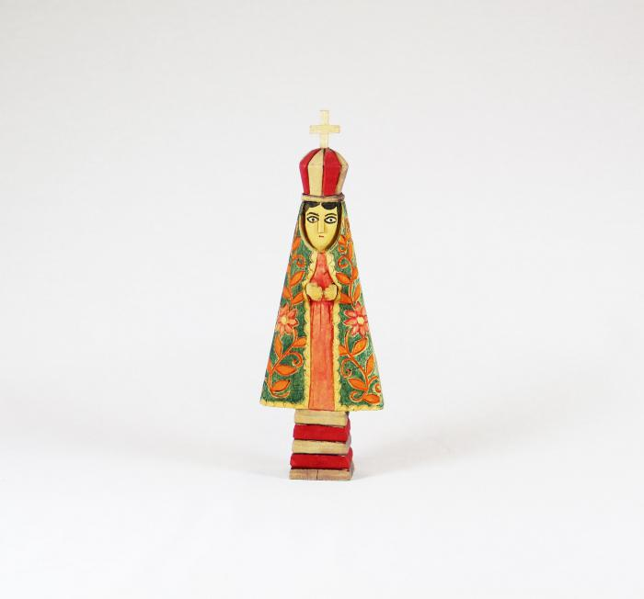
Virgin (M1040)

Slide 21
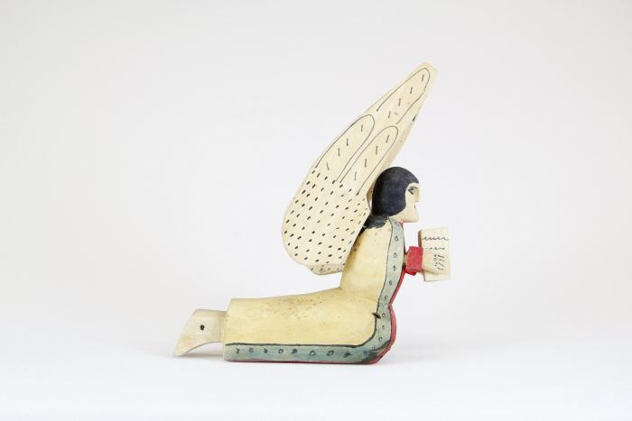
Praying Angel, 1981 (M1041)

Slide 22
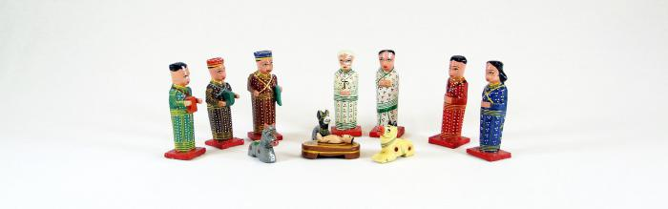
Wood Nativity (12 pieces) (M1063)

Slide 23
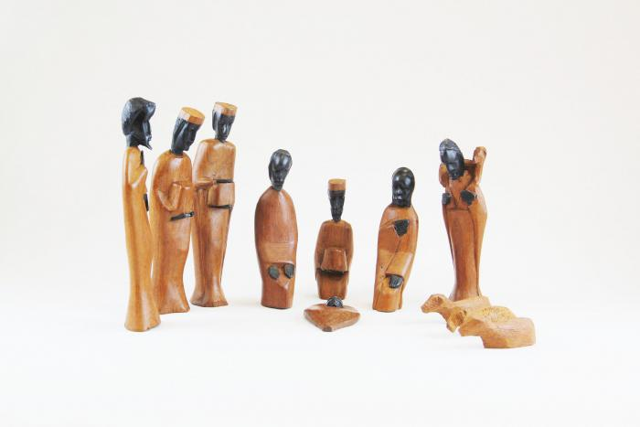
African Nativity (11 pieces) (M1073)

Slide 24
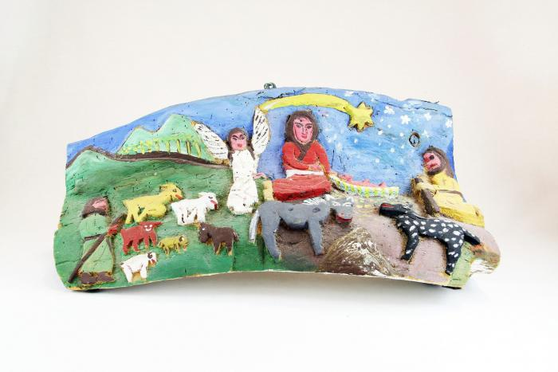
Nativity Bas-Relief Carved from Tree (M1077)

Slide 25
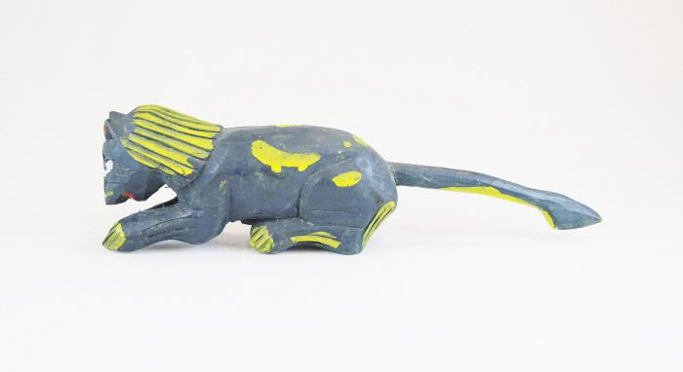
Spotted Feline (M1086)

Slide 26
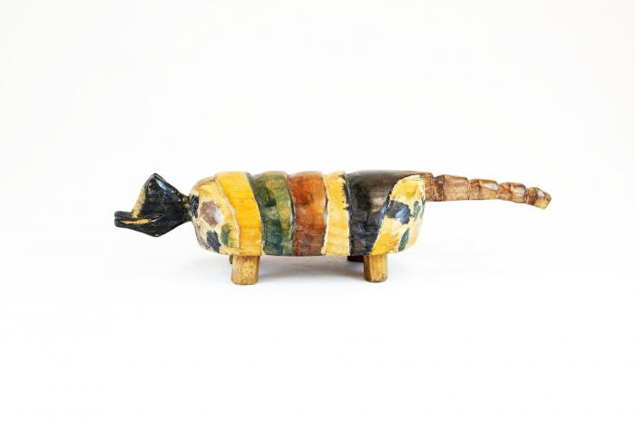
Painted Armadillo (M1088)

Slide 27
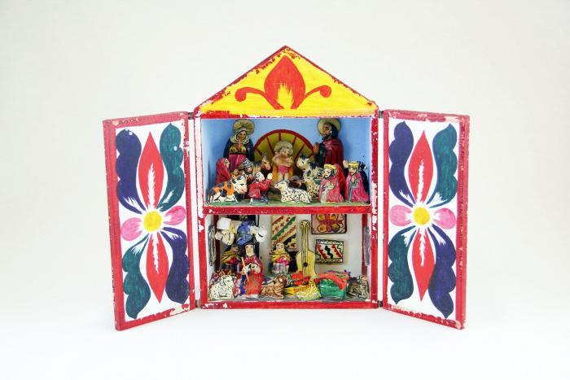
Peruvian Nativity Retablo (M1100)

Slide 28
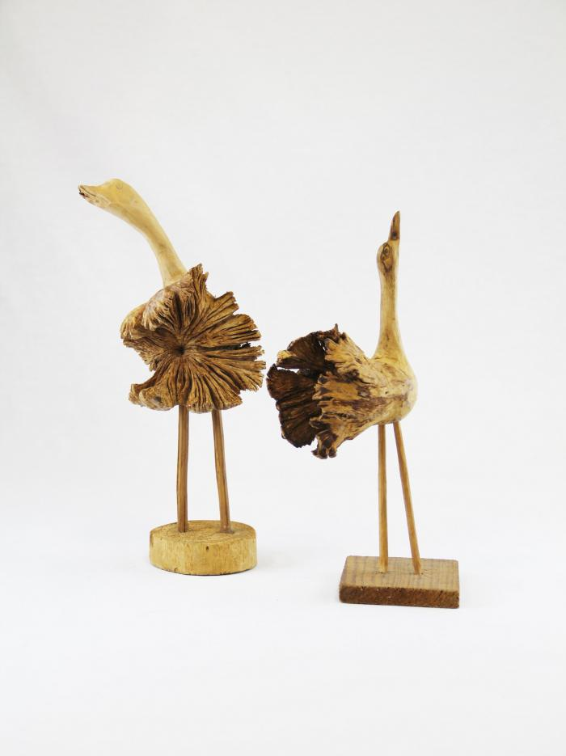
Two Wood Carved Birds (M1552)

Slide 29
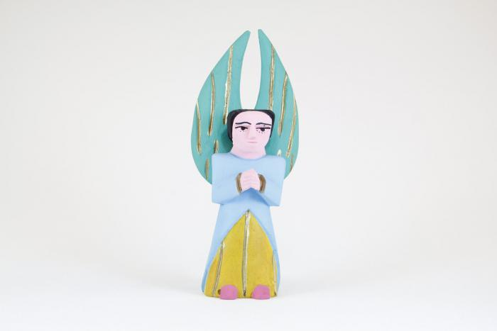
Painted Angel (M1595)

Slide 30
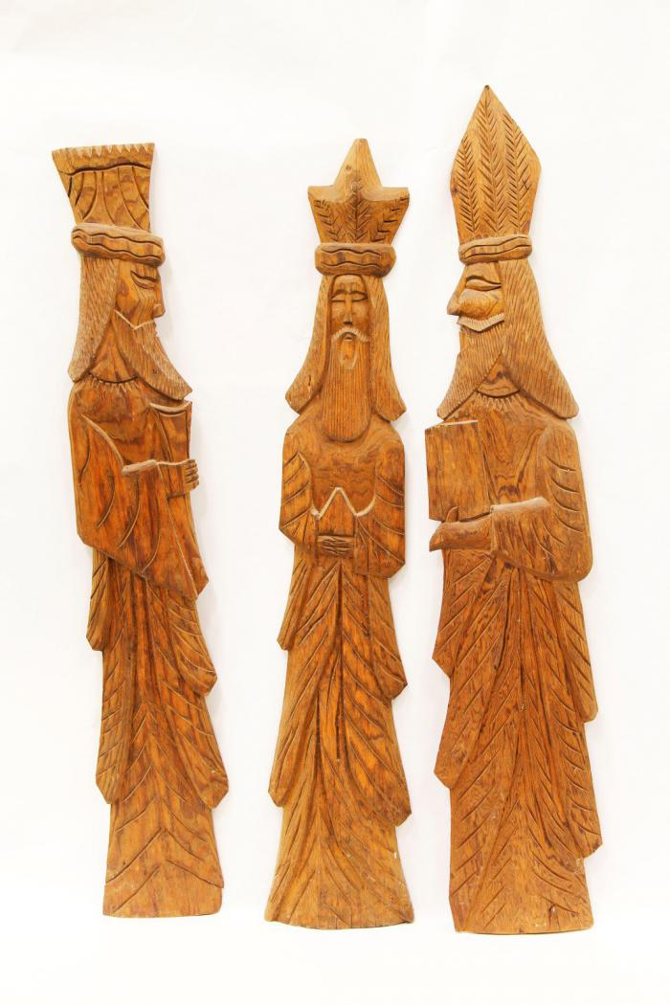
Three Kings (M1603)

Slide 31
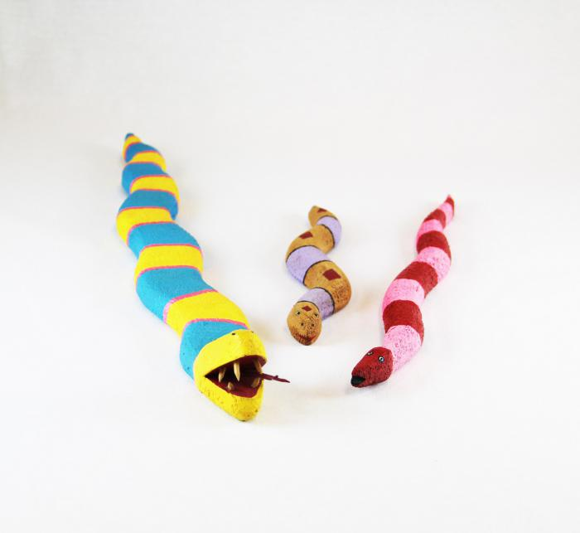
3 Native American Fantasy Snakes (MU3472)

Slide 32
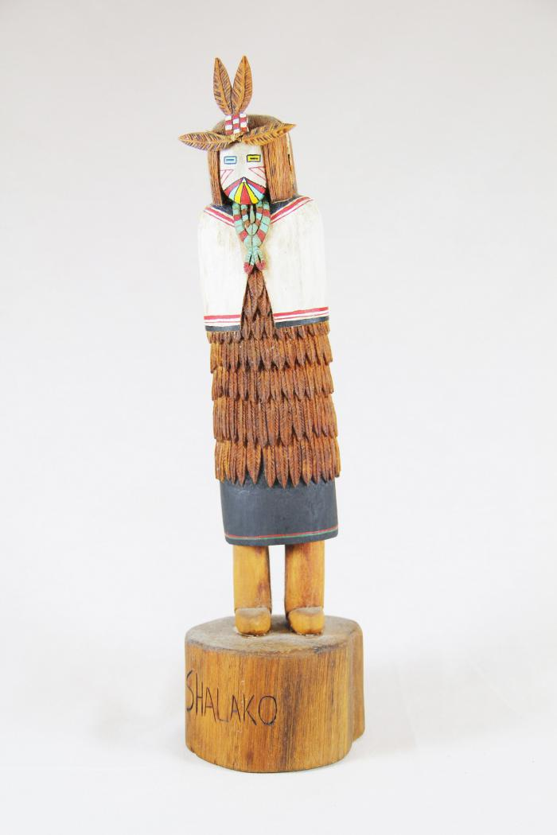
Kachina Doll (Shaloko) (MU3508)

Slide 33
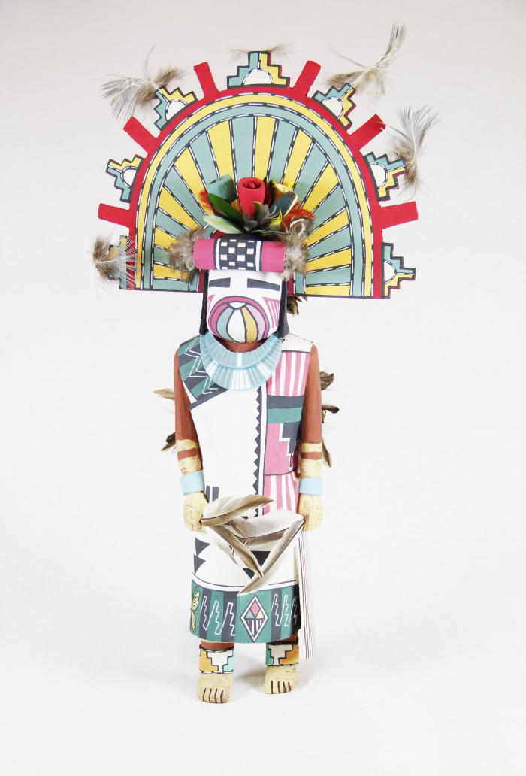
Kachina Doll (Palhik Mana) (MU3509)

Slide 34
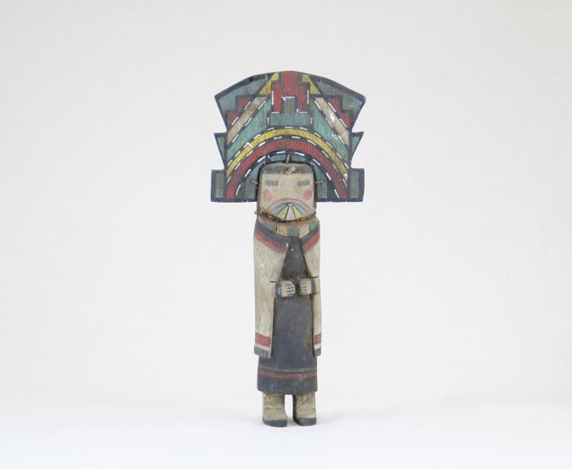
Kachina Doll (MU3510)

Slide 35
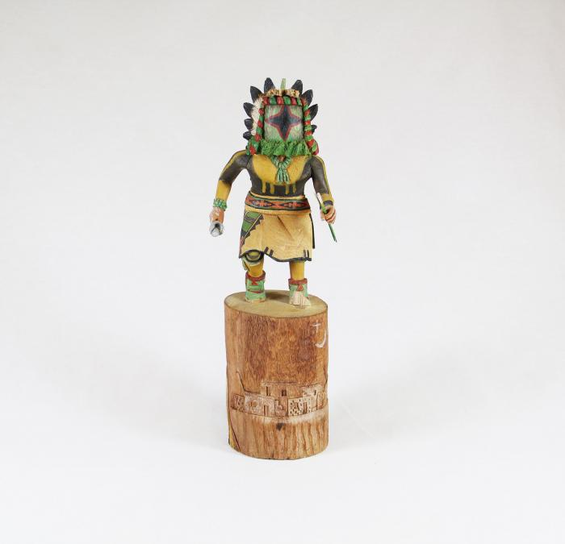
Kachina Doll (Chasing Star) (MU3511)

Slide 36
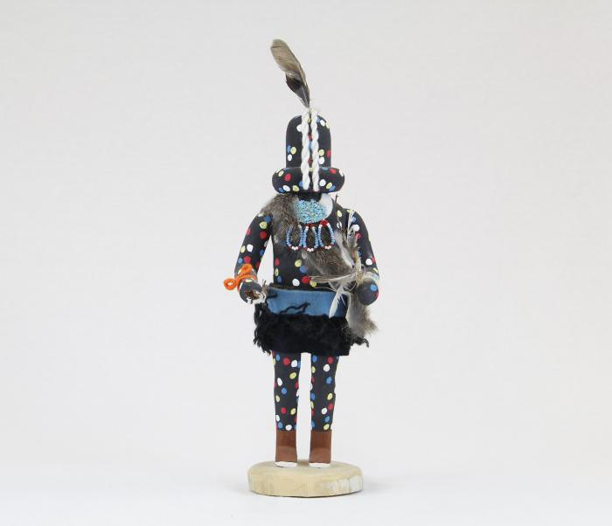
Kachina Doll (Zuni Fire God) (MU3512)

Slide 37
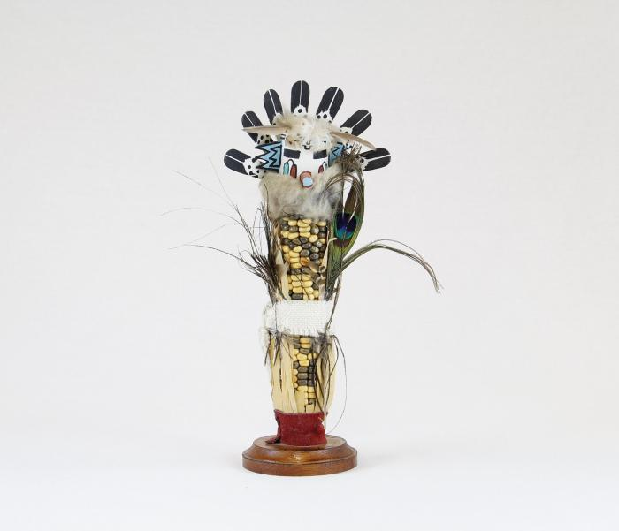
Kachina Doll (Corn Maiden) (MU3513)

Slide 38
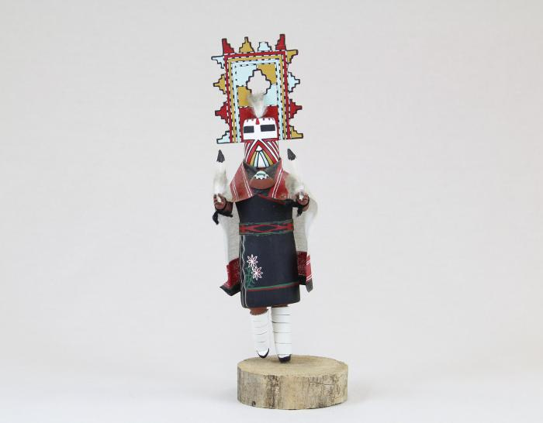
Kachina Doll (Palhik Mana) (MU3515)

Slide 39
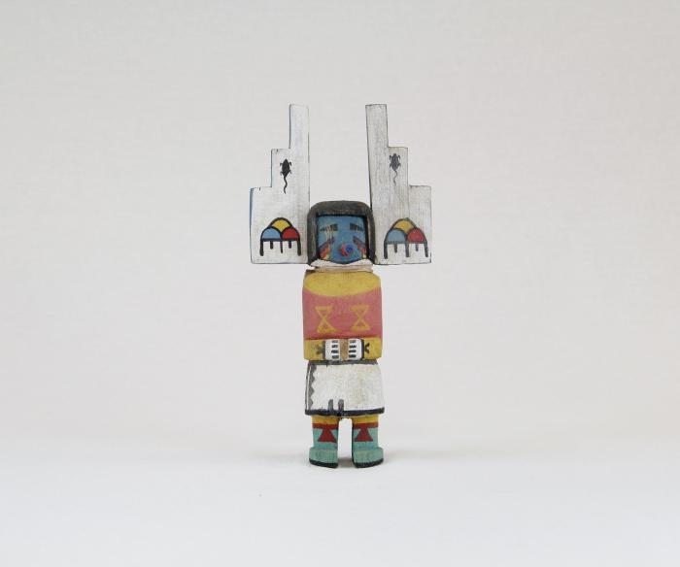
Kachina Doll (MU3516)

Slide 40
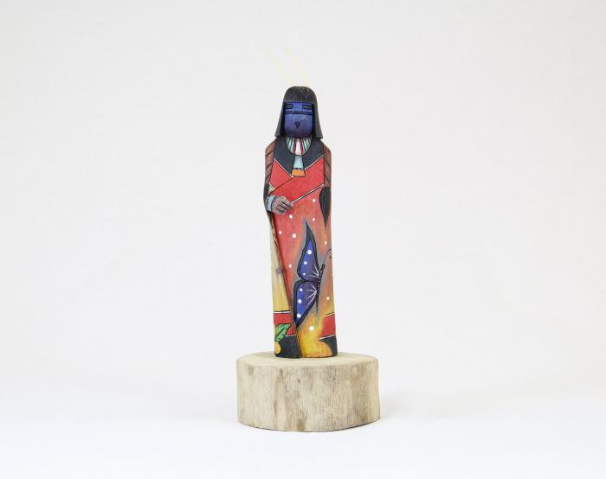
Kachina Doll (Shalako) (MU3517)

Slide 41
Kachina Doll (Ogre Woman) (MU3518)

Slide 42
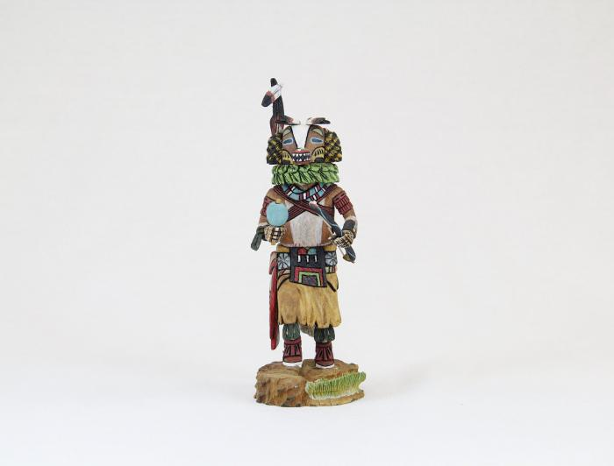
Kachina Doll (Badger) (MU3519)

Slide 43
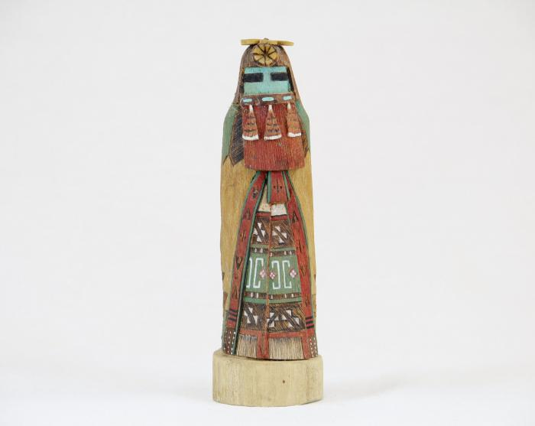
Kachina Doll (Hopi - Red Beard Long Hair) (MU3520)

Slide 44
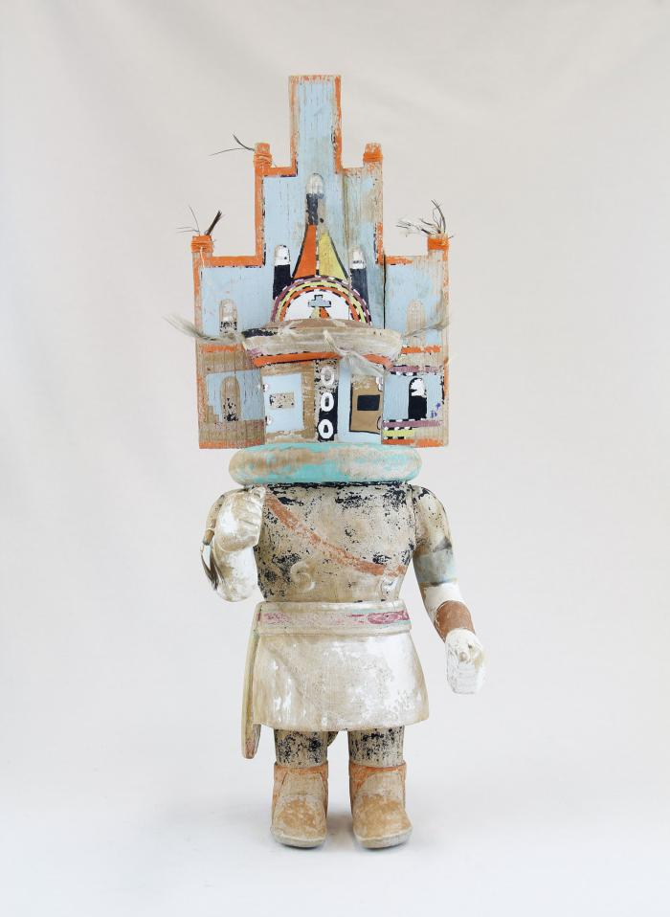
Hopi Hemis Kachina (MU18)

Slide 45
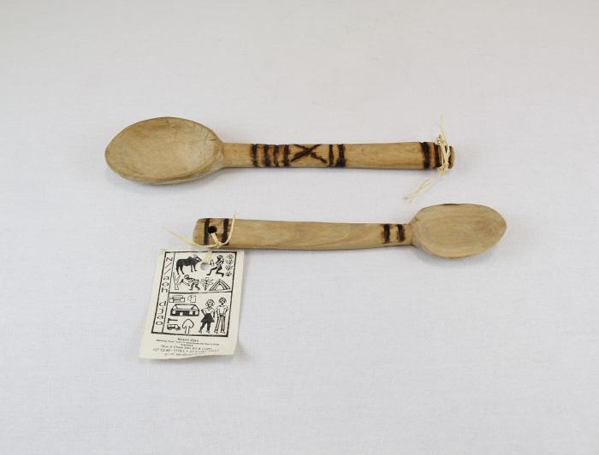
Two Wooden Spoons (MU19)

Slide 46
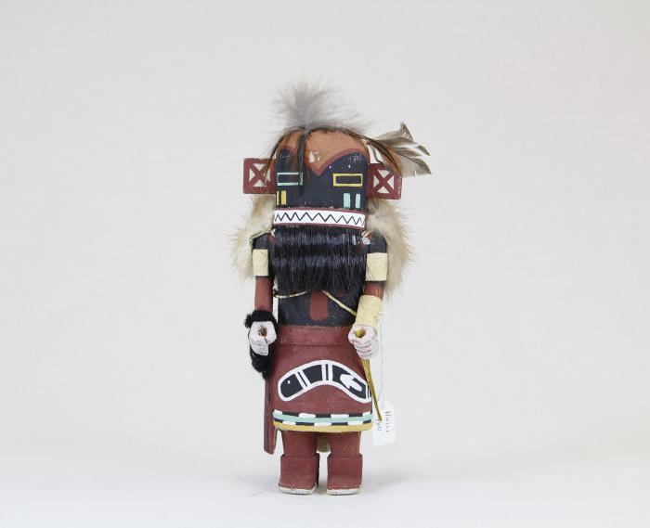
Kachina doll (Hilili) (MU3514)

Slide 47
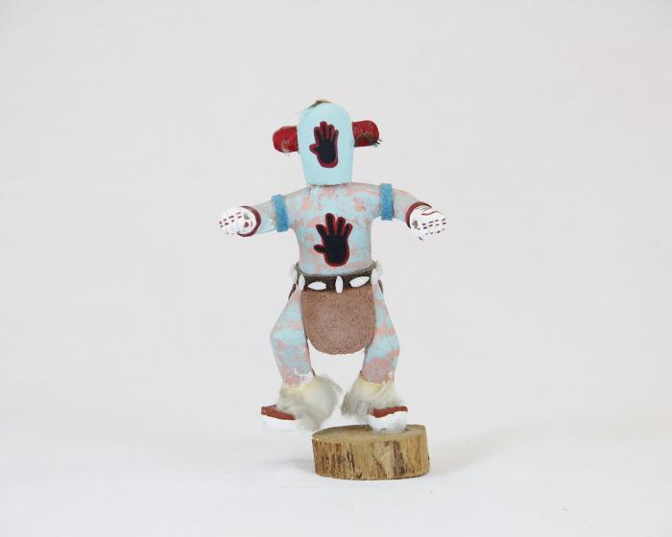
Kachina Doll (Handprint Racer) (MU3521)

Slide 48
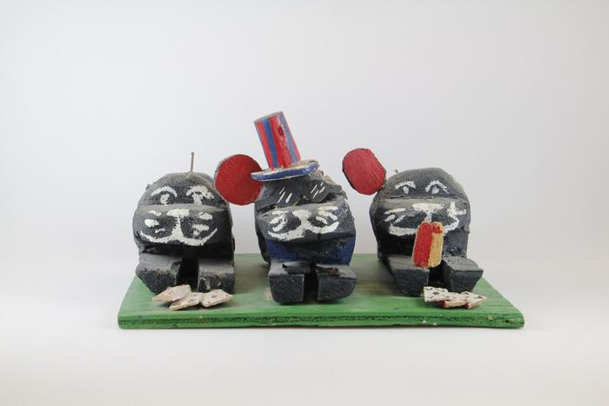
Three Sitting Dogs Playing Cards on Green Plank (EH25)

Slide 49
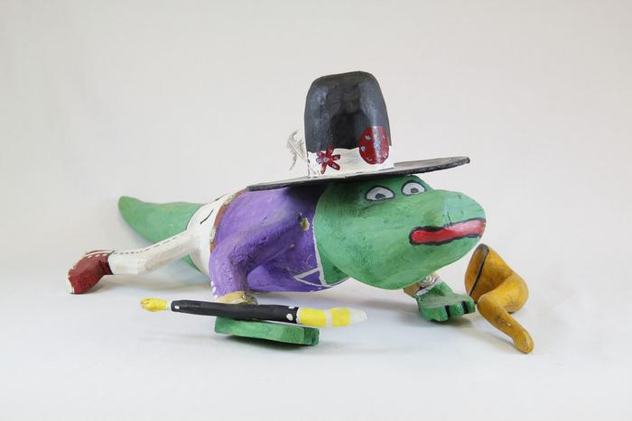
Cowboy Alligator (EH26)

Slide 50
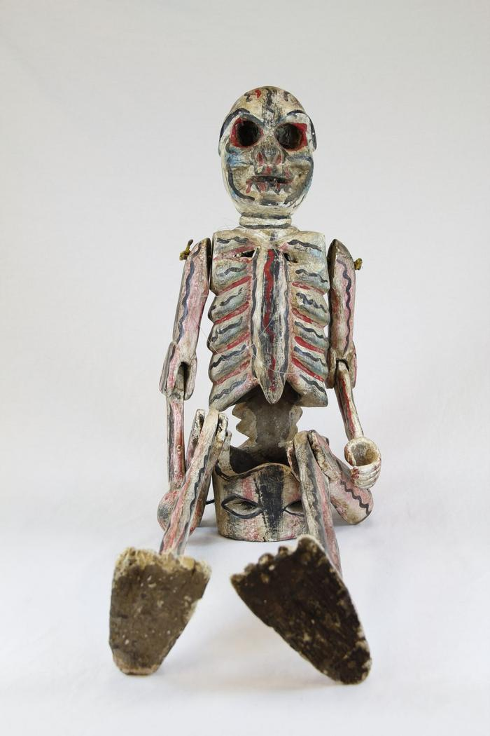
Large Skeleton with Rotating Arms and Legs (EH27)

Slide 51
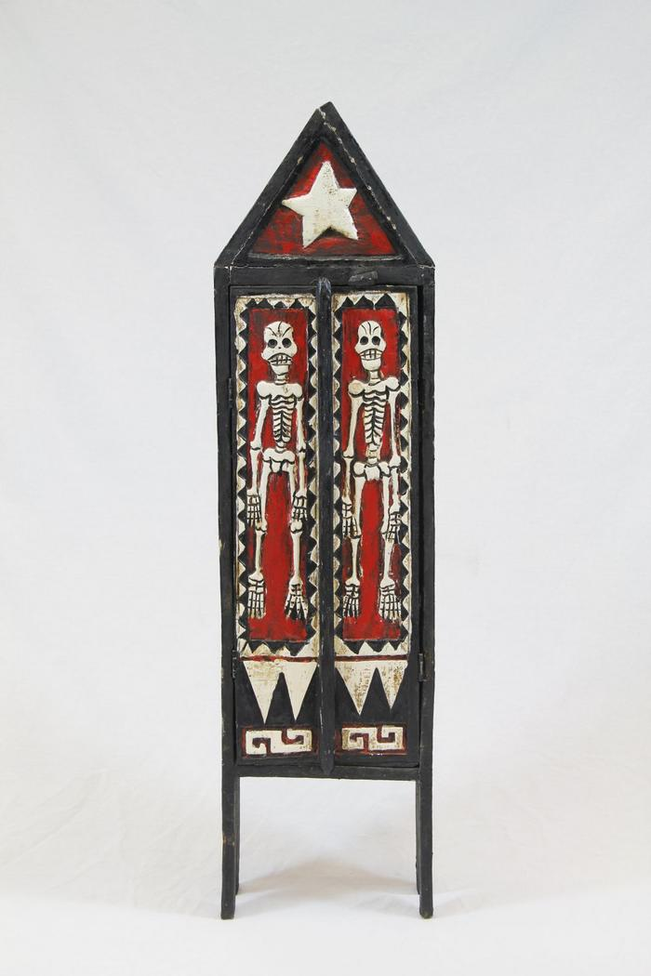
Wood Skeleton Armoire (EH28)

Slide 52

Two Carved Wood Indoor Scenes (EH29)

Slide 53

Howard Finster Eagle and Poem on Board (EH30)

Slide 54

Tiger Table (EH31)

Slide 55

Bat Mask (PR2)

Slide 56

Devil Mask with Two Snakes (PR3)

Slide 57

Mermaid Mask (PR4)

Slide 58

Hermit Mask (PR5)

Slide 59

Goat Mask (PR6)

Slide 60

Mermaid and Bird Mask (PR7)

Slide 61

Old Man Mask (Viejo) (PR8)

Slide 62

Viejito Mask (PR9)

Slide 63

Bat and Mermaid Mask (PR10)

Slide 64

El Barbón Mask (PR12)

Slide 65

Nagual Mask (PR13)

Slide 66

Wood Carved Leopard Mask (PR14)

Slide 67

Diablo-Calavera (Devil-Skull) Mask (PR15)

Slide 68

Moro Pasion Mask (PR18)

Slide 69

Blue Devil Mask (PR21)

Slide 70

Donkey Mask (PR23)

Slide 71

Chané Jaguar Mask (PR25)

Slide 72

Ecuadorian Monkey Mask (PR30)

Slide 73

Barong Mask (PR34)

Slide 74

Indonesian Barong Mask (PR35)

Slide 75

Balinese Long Mask with Lizards (PR36)

Slide 76

Gold Jeweled Thai Mask (PR38)

Slide 77

Thai Warrior Mask (PR39)

Slide 78

Jero Luh Mask (PR42)

Slide 79

Meng Liang, white opera mask (PR44)

Slide 80

Okina Mask (PR45)

Slide 81

Okame (Otafuku) Mask (PR47)

Slide 82

Fang Mask from Ghana (PR49)

Slide 83

African Wood Carved Mask (PR50)

Slide 84

Dan Tribe Mask (PR52)

Slide 85

Rectangular Wood Mask (PR54)

Slide 86

Maasai mask (PR55)

Slide 87

Brazilian Carranca Figurehead (PR58)

Slide 88

Christ on Cross with Angels Wood Wall Hanging (MC5)

Slide 89

Wooden Mask, Stained Pink (MC9)

Slide 90

Indonesian Wayang Shadow Puppet (MC10)

Slide 91

Guro Mask (MC13)

Slide 92

Ebony Carved Figures from Makonde Tribe (MC14)

Slide 93

African Long Forehead Mask (MC15)

Slide 94

Agave Plant with Virgin of Guadalupe (SH1)

Slide 95

Agave Plant with Virgin of Guadalupe (SH2)

Slide 96

Angel (SH4)

Slide 97

Angel (SH5)

Slide 98

Angel (SH6)

Slide 99

Angel holding Book (SH7)

Slide 100

Angel holding Dove (SH8)

Slide 101

Angel kneeling (SH10)

Slide 102

Angel playing Guitar (SH11)

Slide 103

Angel playing Harp (SH12)

Slide 104

Angel with Small Angel (SH15)

Slide 105

Animal Band (SH16)

Slide 106

Animal playing an Electric Guitar (SH18)

Slide 107

Armadillo (SH19)

Slide 108

Armadillo (SH20)

Slide 109

Bird Cage with Tree (SH22)

Slide 110

Blue Animal (SH32)

Slide 111

Blue Goat (SH33)

Slide 112

Blue Rattle Snake (SH34)

Slide 113

Cactus (SH38)

Slide 114

Cactus blooming Pink Flower (SH39)

Slide 115

Cactus with Three Virgins (SH40)

Slide 116

Cart with Cows (SH41)

Slide 117

Centaur playing Violin (SH43)

Slide 118

Chicken with Chicks (SH44)

Slide 119

Cows with Cart (SH45)

Slide 120

Crocodile (SH46)

Slide 121

Danza de la Pluma (SH48)

Slide 122

Danza de la Pluma (SH49)

Slide 123

Dancing Man with Bird (SH50)

Slide 124

Decorated Cows with Cart (SH53)

Slide 125

Desert Scene (SH54)

Slide 126

Dog playing Guitar (SH55)

Slide 127

Dragon (SH56)

Slide 128

Dragon (SH57)

Slide 129

Dragon (SH58)

Slide 130

East African Ngoma (SH59)

Slide 131

Elephant (SH60)

Slide 132

Makonde Shetani Sculpture (SH62)

Slide 133

Firework Castle (SH63)

Slide 134

Firework Dancing man (SH64)

Slide 135

Garuda (SH66)

Slide 136

Deer Alebrije (SH71)

Slide 137

Humming Bird (SH72)

Slide 138

Kneeling Angel (SH73)

Slide 139

Women selling Goods (SH77)

Slide 140

Lion (SH81)

Slide 141

Lizard (SH82)

Slide 142

Lizard (SH83)

Slide 143

Lizard (SH84)

Slide 144

Longhaired Maiden (SH85)

Slide 145

Man with Whip (SH89)

Slide 146

Mermaids on Beach (SH92)

Slide 147

Monk with Bird (SH93)

Slide 148

Mother Skunk (SH94)

Slide 149

Multi Color Bikini Cat Band (SH95)

Slide 150

Oaxacan Plume Dancer (SH96)

Slide 151

Palm Tree with Feeding Bird (SH98)

Slide 152

Pink Flower (SH99)

Slide 153

Purple Angel holding Flower (SH100)

Slide 154

Rabbit (SH101)

Slide 155

Rat Woodcarving (SH102)

Slide 156

Rooster (SH105)

Slide 157

Saint Francis of Assisi (SH106)

Slide 158

Saint Michael (SH107)

Slide 159

Skeleton Band (SH109)

Slide 160

Toucan (SH113)

Slide 161

Wood Carved Turtles (SH114)

Slide 162

Virgin de Guadalupe (SH118)

Slide 163

Virgin de la Soledad (SH122)

Slide 164

Virgin Mary (SH124)

Slide 165

Virgin Mary with Man kneeling (SH126)

Slide 166

Virgin of Guadalupe (SH127)

Slide 167

Virgin of Guadalupe Cactus (SH128)

Slide 168

Woman making a Rug (SH130)

Slide 169

Carved Wooden Bowl (SHA7)

Slide 170

Shipibo Blowgun (SHA16)

Slide 171

Shipibo Blowgun (damaged) (SHA17)

Slide 172

Shipibo Ceremonial Club (SHA18)

Slide 173

Shipibo Paddle (SHA19)

Slide 174

Shipibo Bow (SHA20)

Slide 175

Shipibo Fishing Arrows (SHA21)

Slide 176

Carved Wood Ladle (YO6)

Slide 177

Yangban Mask (WI32)

Slide 178

Akua'ba (DE1)

Slide 179

Chinese Wood Carved Panel (FR19)

Slide 180

Tibetan Miniature Village (FR20)

Slide 181

Tibetan Wood Printing Block (FR33)

Slide 182

Tibetan Six Panel Printing Block (FR34)

Slide 183

Painted Cofre Box by Otzoy (FR48)

Slide 184

Painted Cofre by Filiberto Simon (FR49)

Slide 185

Guatemalan Chicken Candle Holder (FR50)

Slide 186

Guatemalan Rooster (FR51)

Slide 187

Balaram Suvadra Idols (FR69)

Slide 188

Wood Carved Box (FR70)

Slide 189

Indian Woman Figure (FR71)

Slide 190

Hindu Wood Painting (FR72)

Slide 191

Rajasthan Kavad Box (FR73)

Slide 192

Sandalwood Carved Cigarette Box (FR74)

Slide 193

Wood Carved Boat and Fisherman (FR101)

Slide 194

Mexican Wooden Fish Child's Toy (FR102)

Slide 195

Wood Carved Armadillos (FR103)

Slide 196

Wooden Virgin (FR104)

Slide 197

Deer Mask (FR105)

Slide 198

Mexican Clacker Toy (FR106)

Slide 199

Papua New Guinea Crocodile Boat (FR114)

Slide 200

Peruvian Painted Box (FR137)

Slide 201

Zaramo "Mwana Hiti" Doll Figure (FR145)

Slide 202

Thai Spirit House (FR146)

Slide 203

Inuit Inukshuk Figurine (FR155)

Slide 204

Wooden Toy Truck (FR172)

Slide 205

Wood Stirrup (FR173)

Slide 206

Basket (FR174)

Slide 207

Lobi Stool (FR175)

