Slide 1
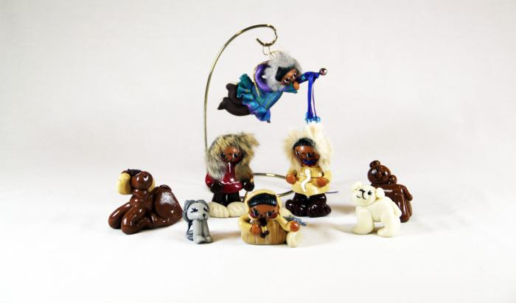
Eskimo Nativity (14 pieces) (M1096)

