Slide 1
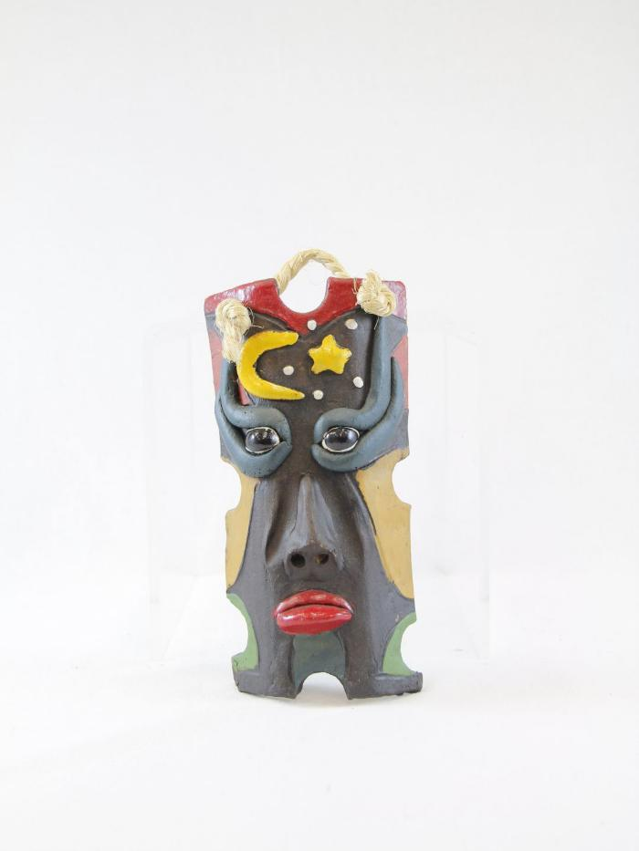
Moon and Star Ceramic Mask (PR26)

Slide 2
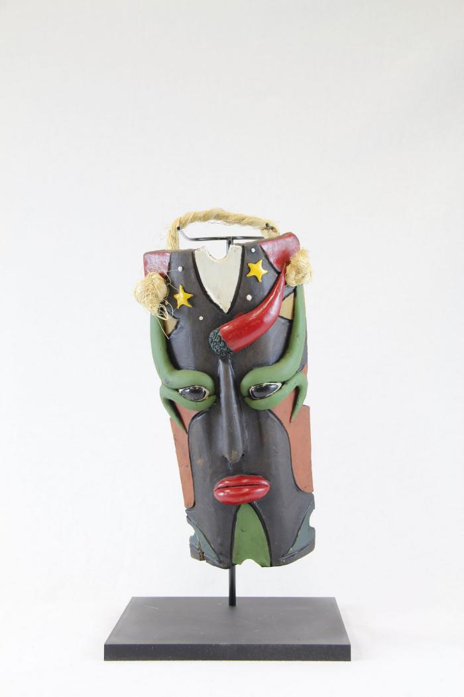
Stars Ceramic Mask (PR27)

