Slide 1
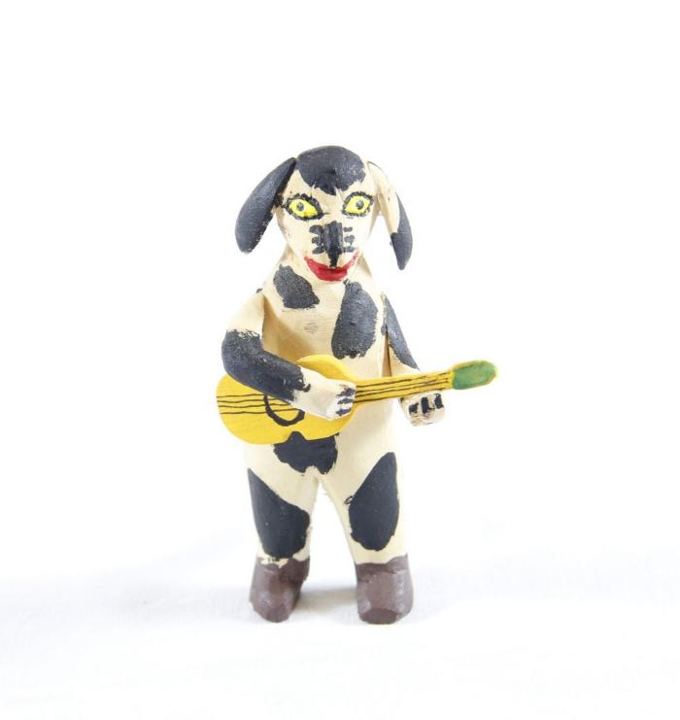
Dog playing Guitar (SH55)

