Slide 1
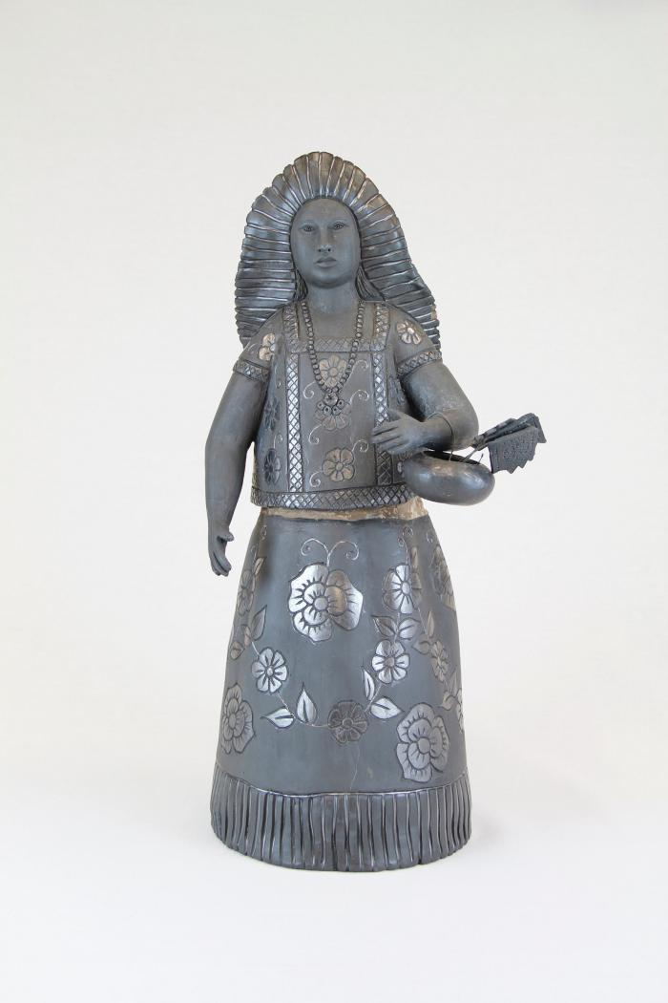
Black Maiden with Basket (M1023)

Slide 2
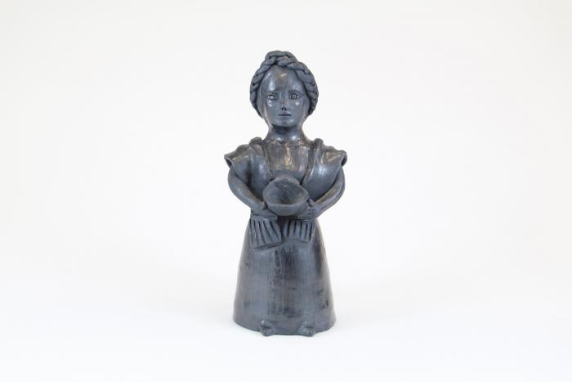
Muñeca holding Bowl (M1024)

Slide 3
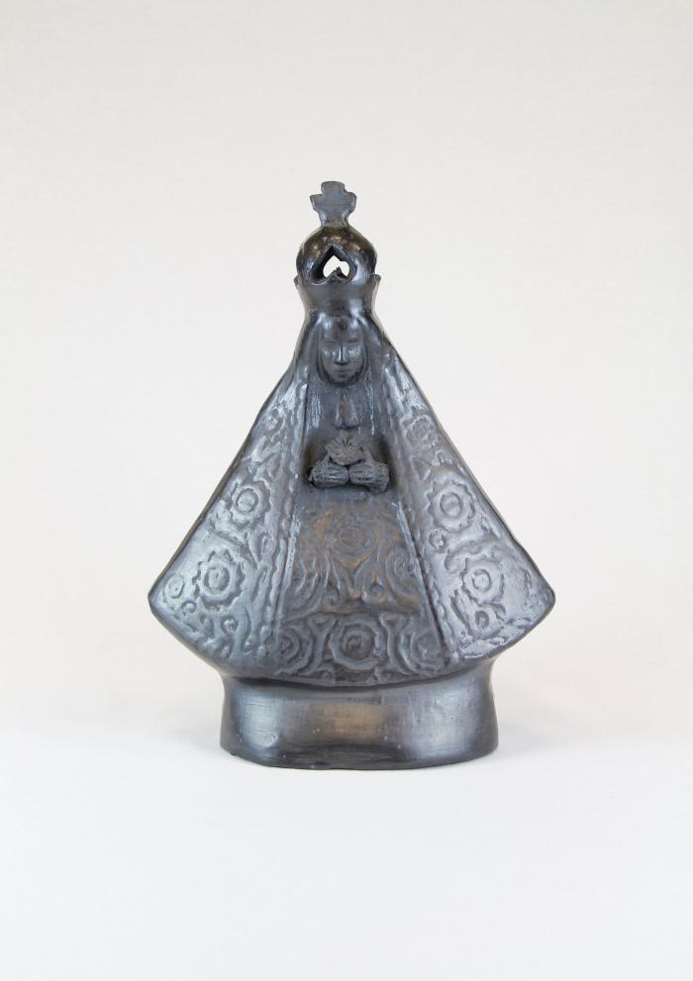
Black Clay Virgen de la Soledad (M1025)

Slide 4
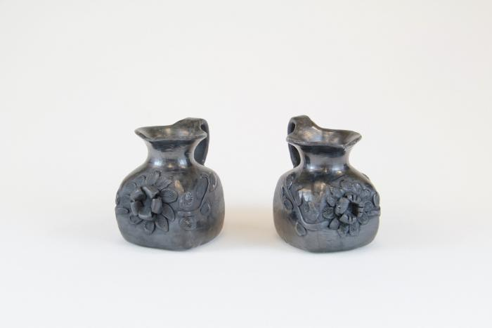
Black Clay Pitchers (M1026)

Slide 5
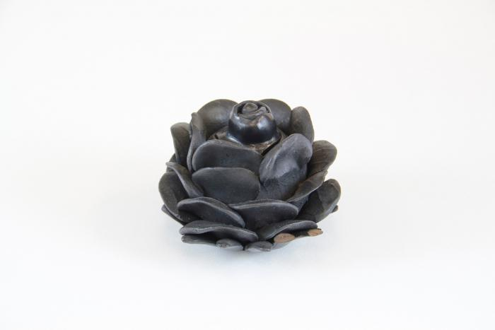
Black Clay Flower (M1027)

Slide 6
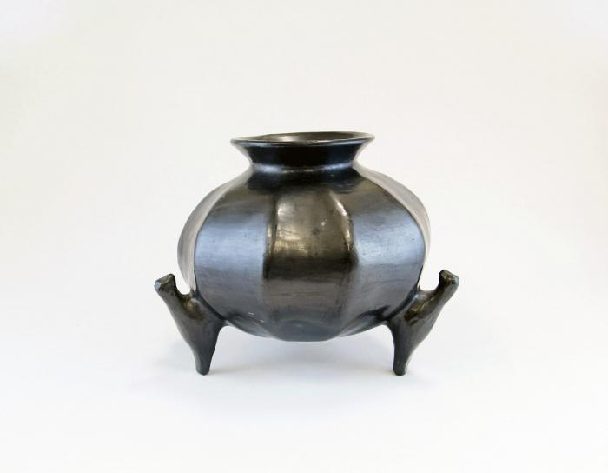
Barro Negro Round Pot (M1092)

Slide 7
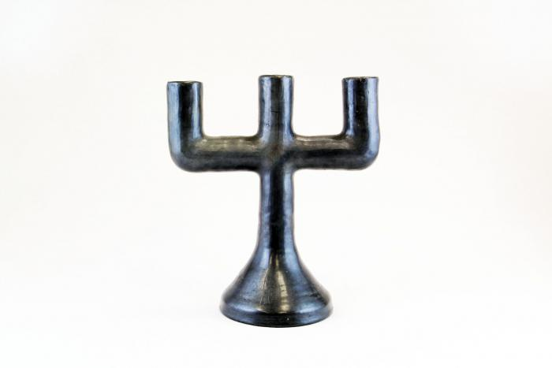
Barro Negro Candelabra (M1109)

Slide 8
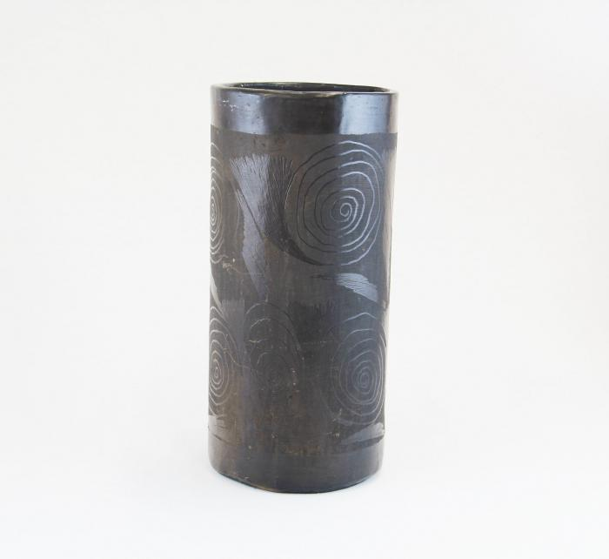
Barro Negro Vase (M1605)

Slide 9
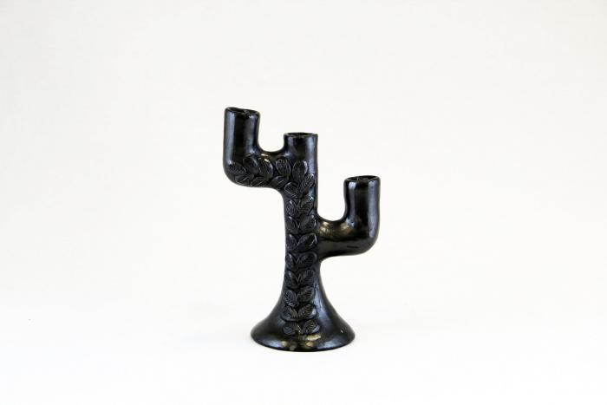
Black Clay Candelabra (M1606)

Slide 10
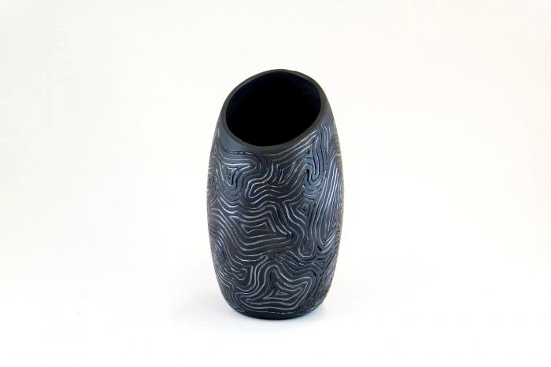
Barro Negro Incised Vase (M1607)

Slide 11
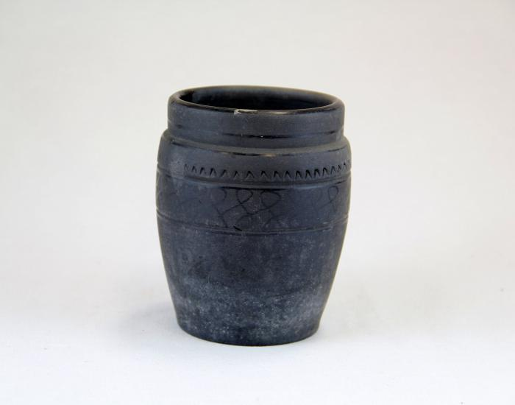
Barro Negro Pot (M1608)

