Slide 1
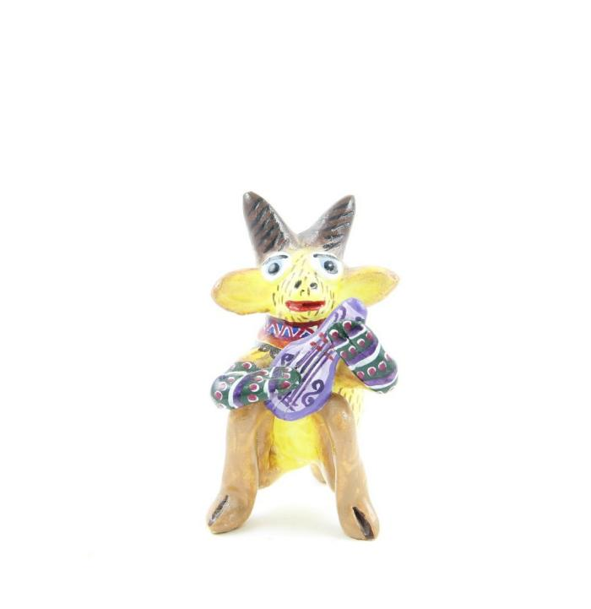
Goat with Guitar (SH68)

