Slide 1
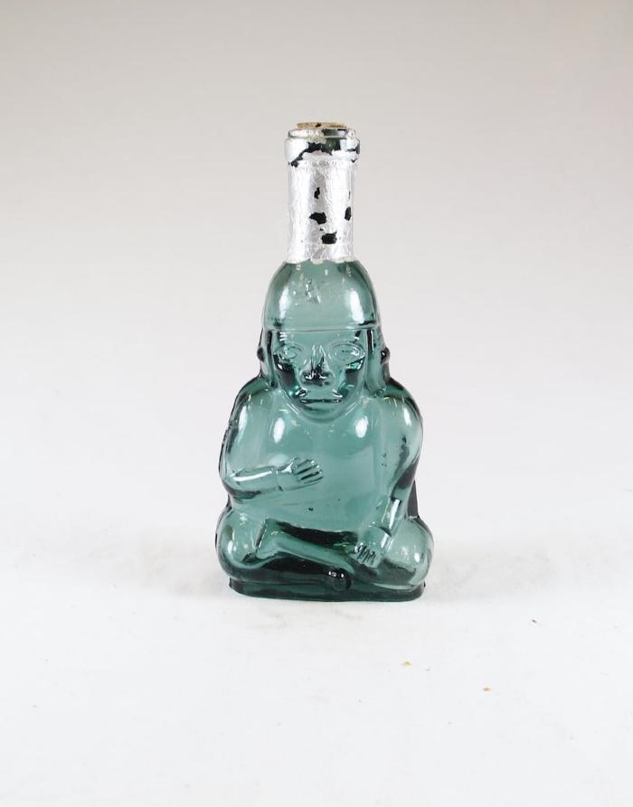
Pisco Figural Bottle (SHA8)

Slide 2
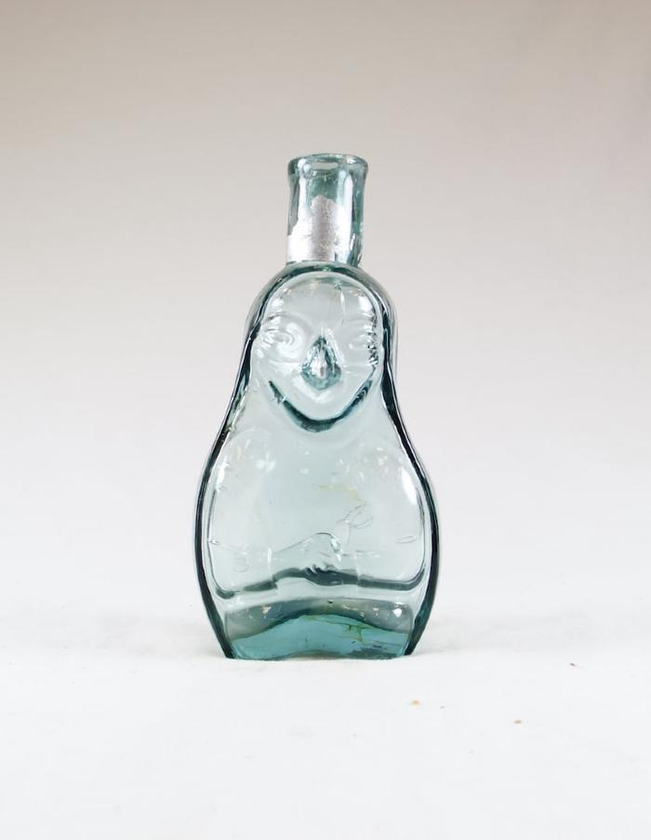
Pisco Figural Bottle (SHA9)

