Slide 1
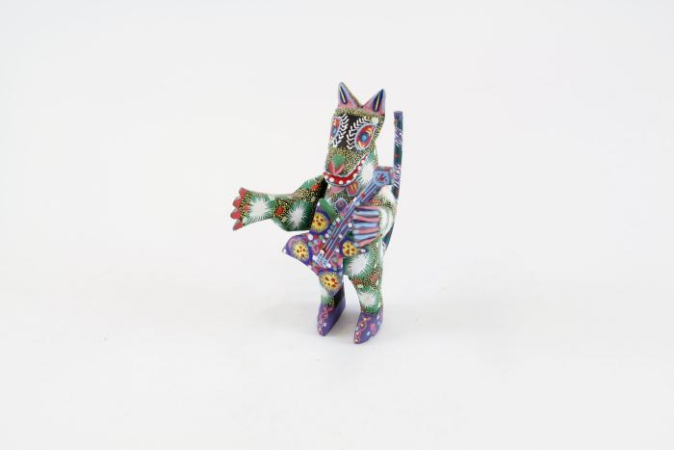
Animal playing an Electric Guitar (SH18)

