Slide 1
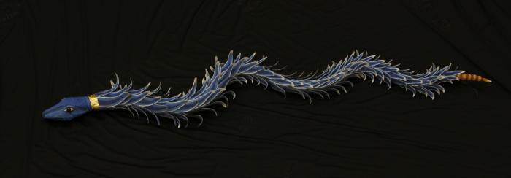
Blue Rattle Snake (SH34)

