Slide 1
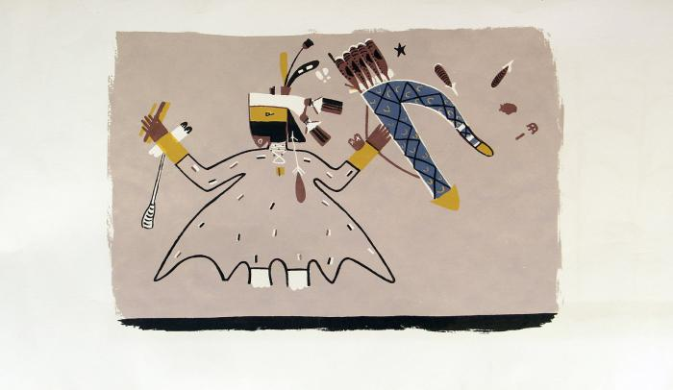
Paper scroll with rendering of mural on the interior walls of a painted kiva in the Southwest area (MU3528)

