Slide 1
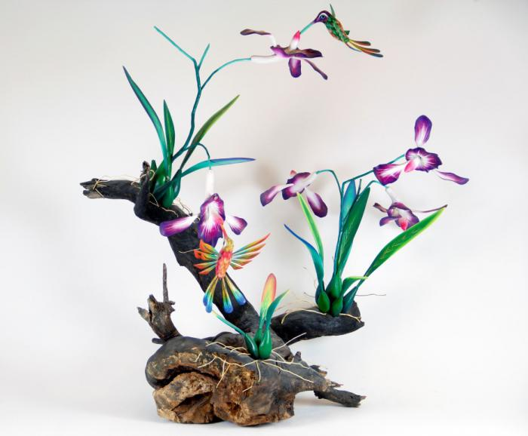
Orchid and Hummingbirds on driftwood base (CA26)

