Slide 1
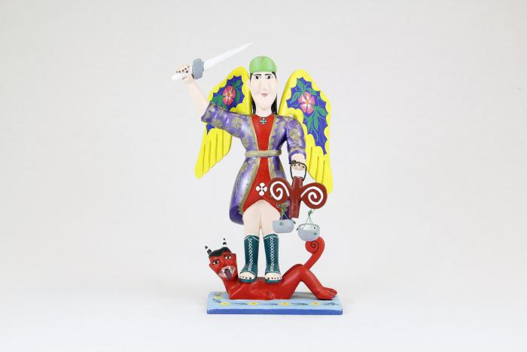
St. Michael with wings, sword and scales (CA2)

