Slide 1
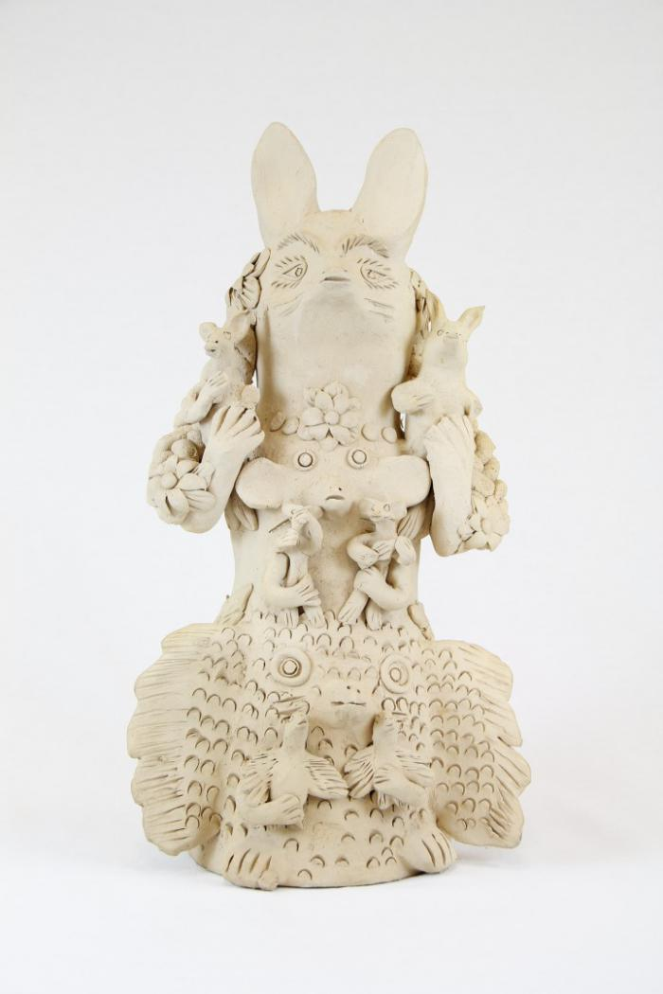
Rabbit Totem (M1029)

Slide 2
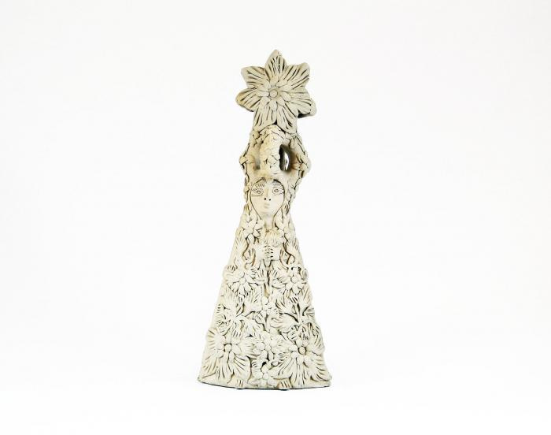
White Clay Virgin covered with Flowers (M1030)

