Slide 1
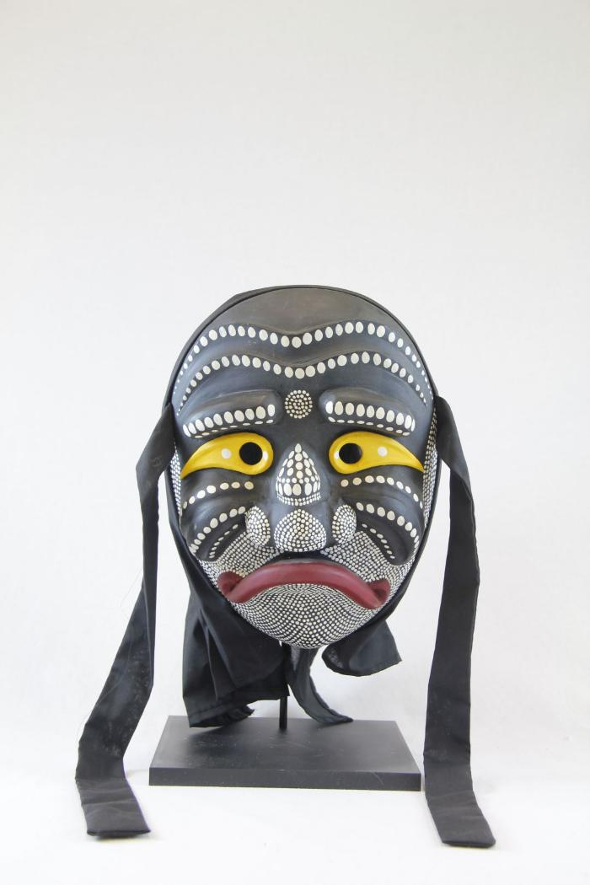
Nojang (monk) mask (PR48)

Slide 2
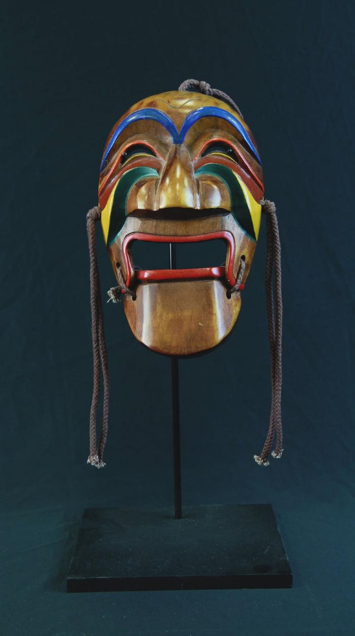
Yangban Mask (WI32)

