Slide 1
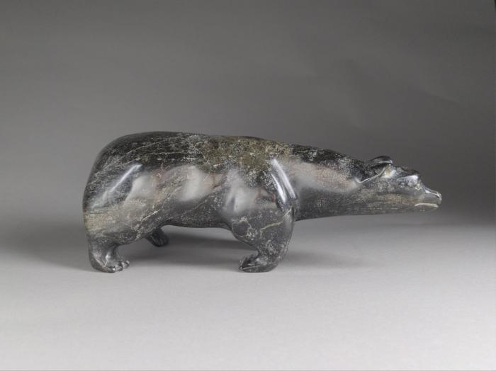
Inuit Stone Carved Bear (FR9)

Slide 2
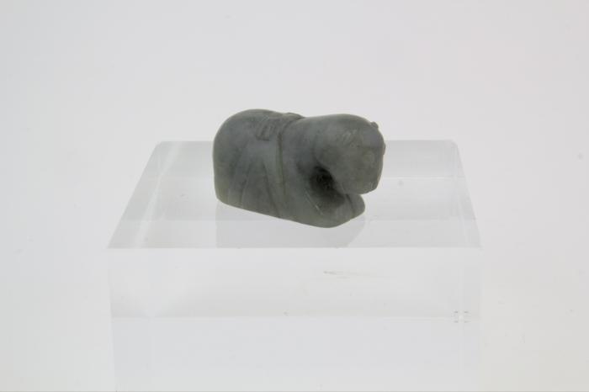
Jade Horse Incense Burner (FR14)

Slide 3
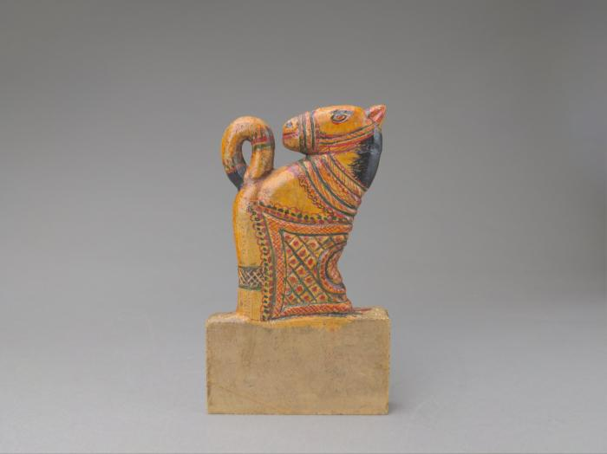
Stone Carved Horse Sculpture (FR64)

