Slide 1
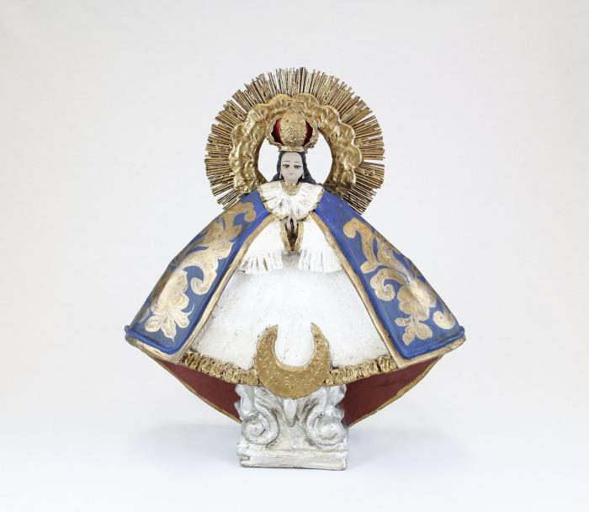
Nuestra Senora de la Salud (CA1)

Slide 2
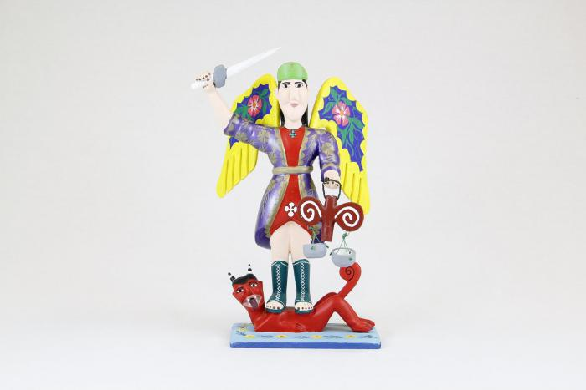
St. Michael with wings, sword and scales (CA2)

Slide 3
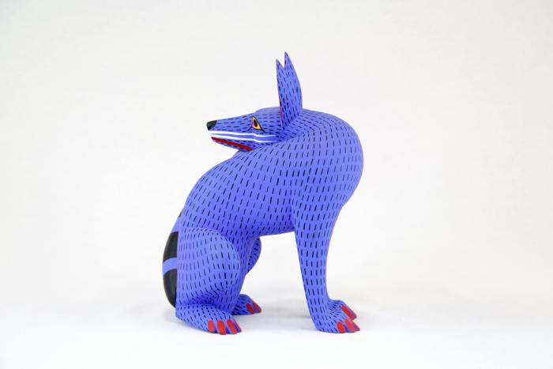
Coyote (CA3)

Slide 4
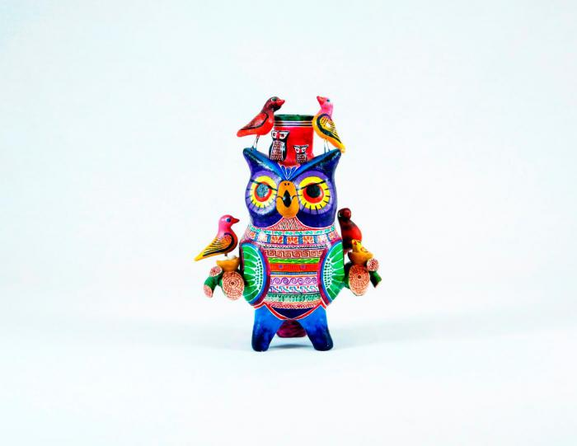
Owl Candleholder (CA4)

Slide 5
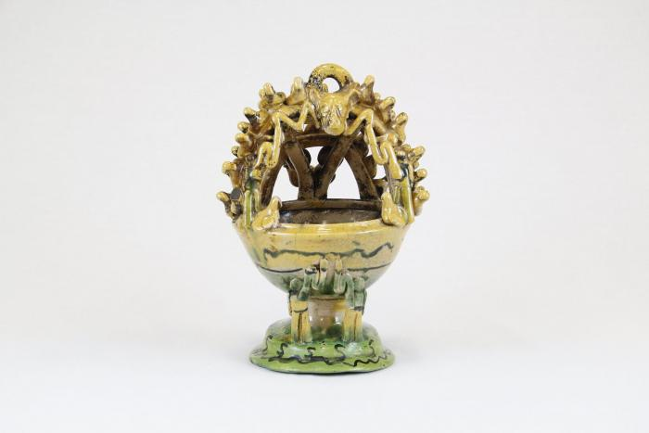
Mayolica Incense Burner (CA5)

Slide 6
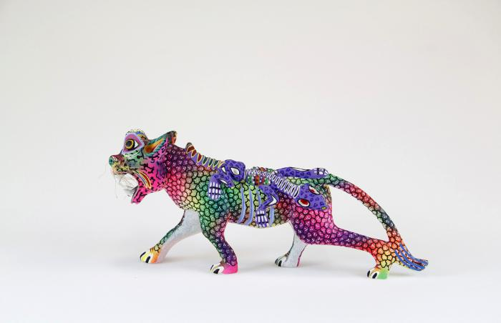
Whiskered jaguar with lizard (CA6)

Slide 7
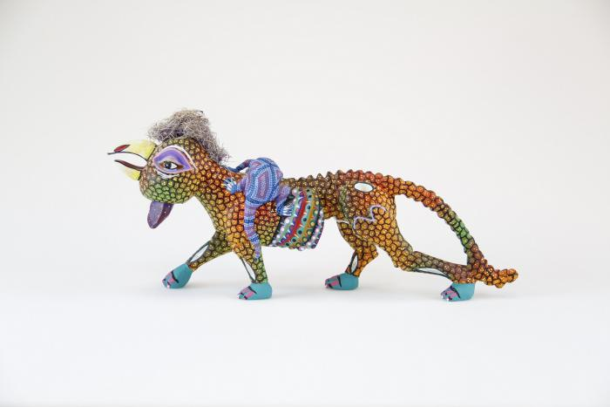
Rooster headed jaguar with lizard (CA7)

Slide 8
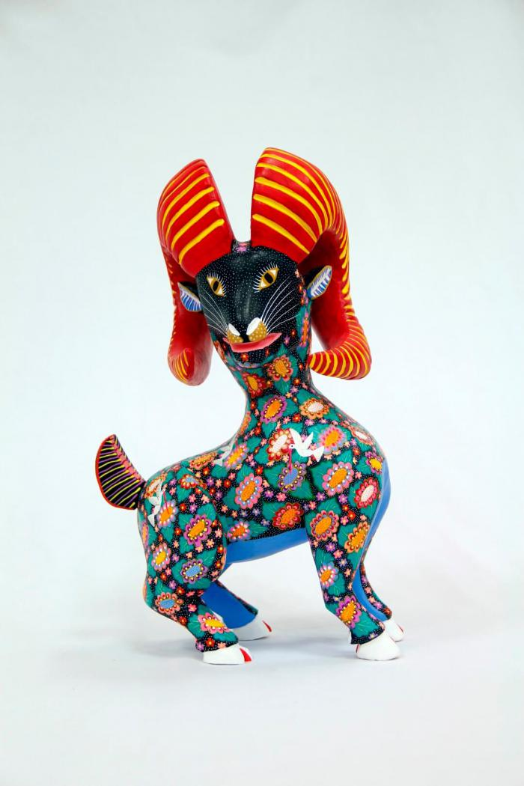
Horned goat (CA8)

Slide 9
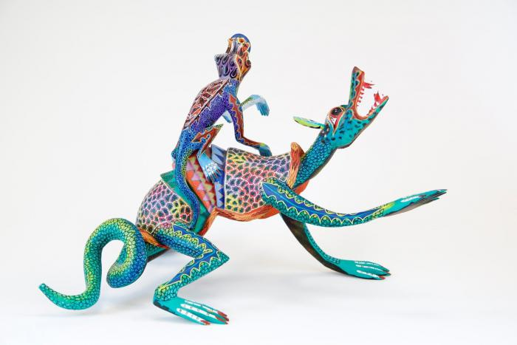
Two lizards (CA9)

Slide 10
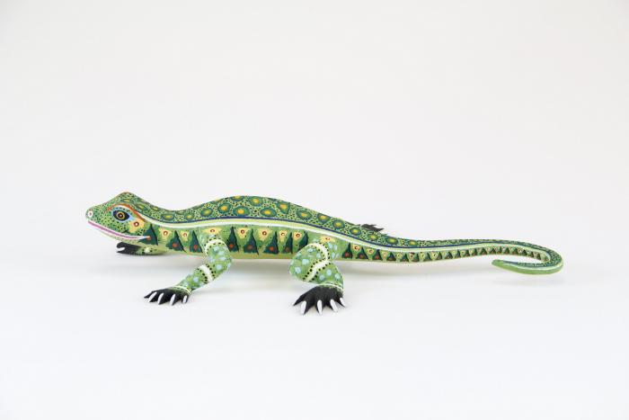
Lizard (CA10)

Slide 11
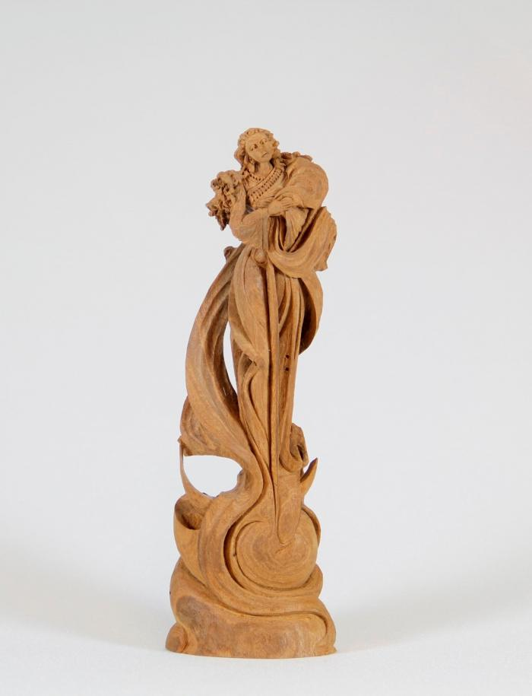
Angel (CA11)

Slide 12
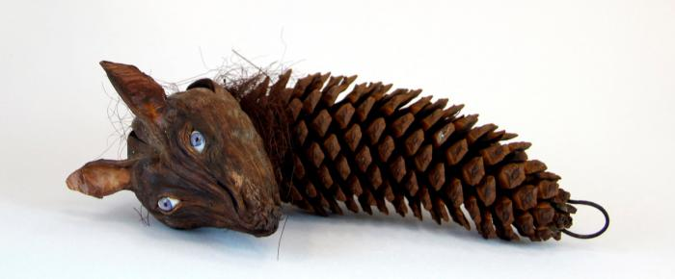
wolf head on pine cone (CA12)

Slide 13
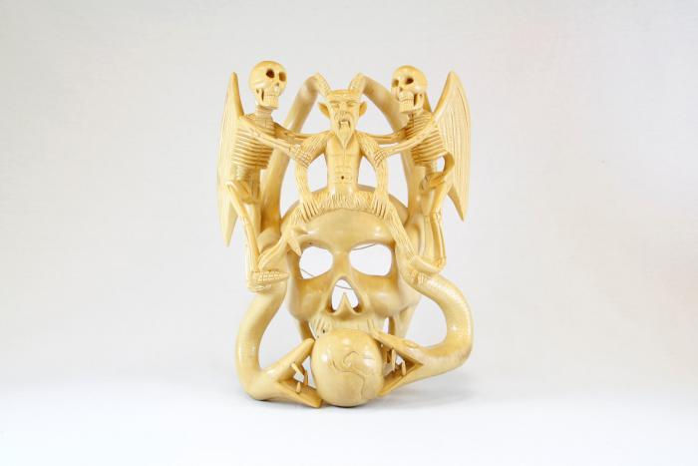
Skull mask (CA13)

Slide 14
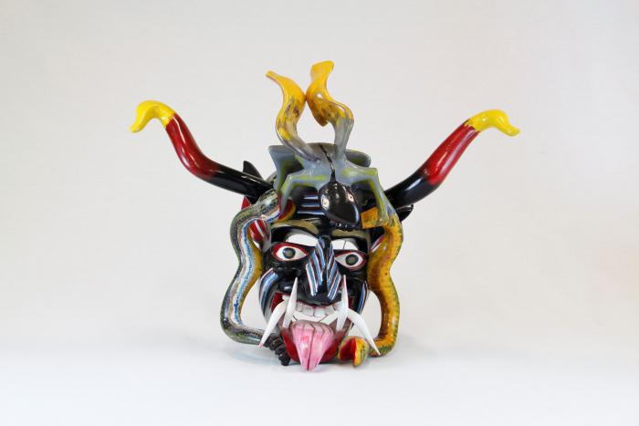
Devil mask with 2 snakes, horns (CA14)

Slide 15
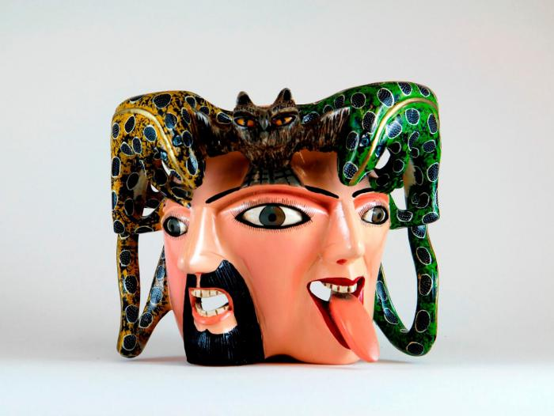
Male / female mask owl and lizards on top (CA15)

Slide 16
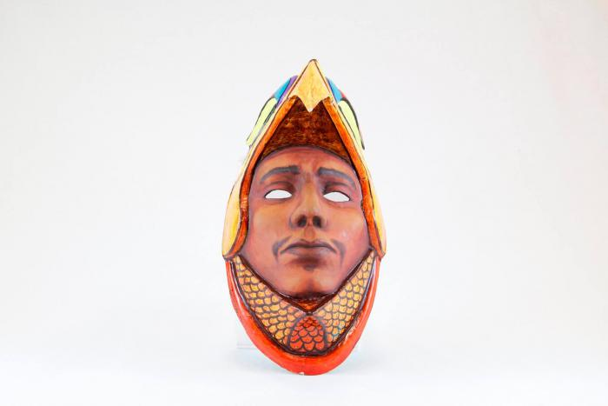
Eagle Warrior mask (CA16)

Slide 17
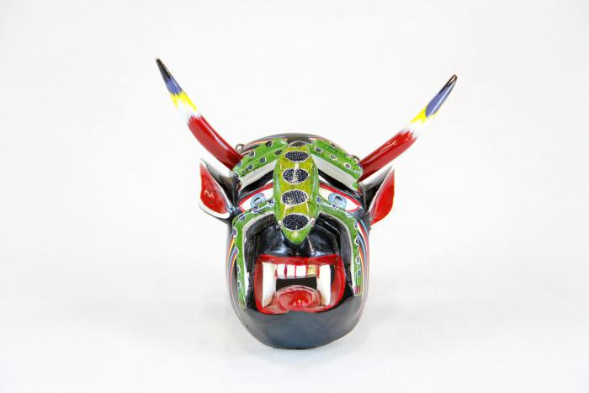
Small devil mask with green lizard (CA17)

Slide 18
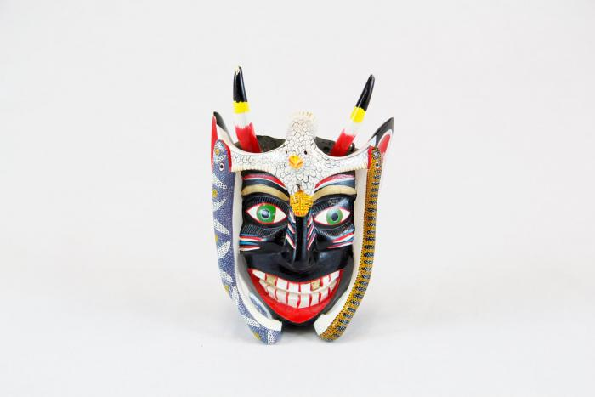
Small black devil mask with bird (CA18)

Slide 19
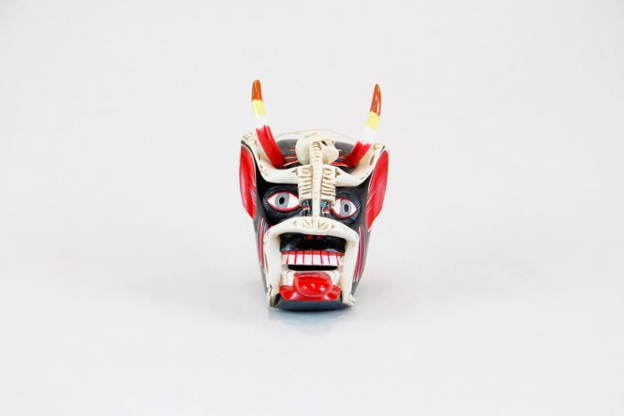
Small devil mask with skeleton (CA19)

Slide 20
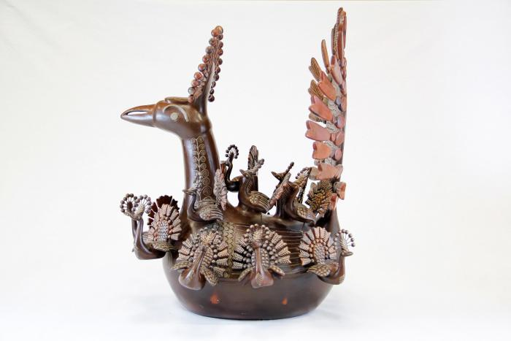
Large peacock with attached baby peacocks and 7 seperate baby peacocks (CA20)

Slide 21
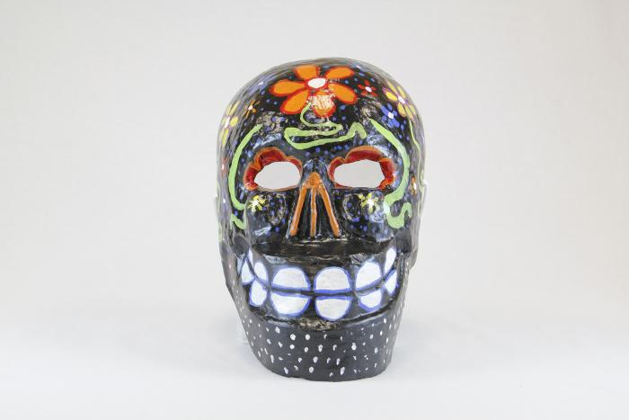
Large black skull mask with flowers (CA21)

Slide 22
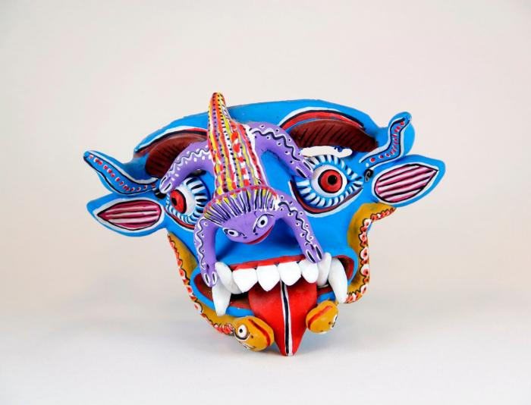
Blue Devil mask with purple toad and 2 snakes (CA22)

Slide 23
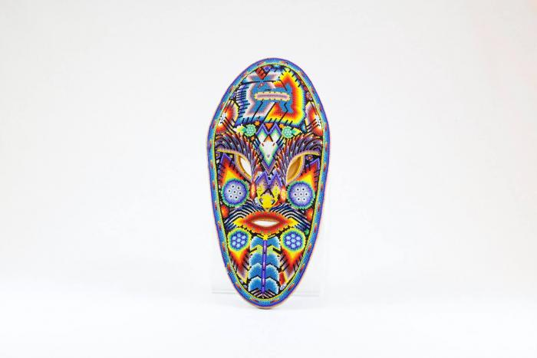
Huichol mask (CA23)

Slide 24
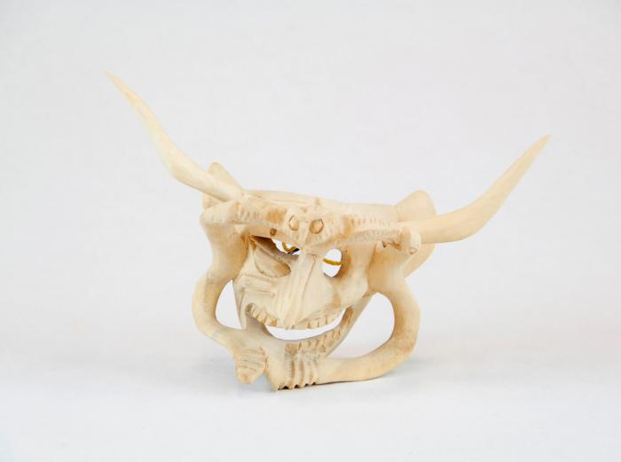
Devil Mask w/ two serpents and owl (CA24)

Slide 25
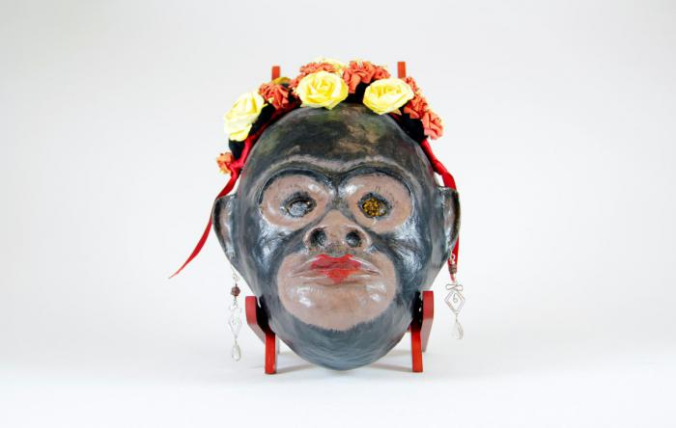
Monkey mask with flowers and earrings (CA25)

Slide 26
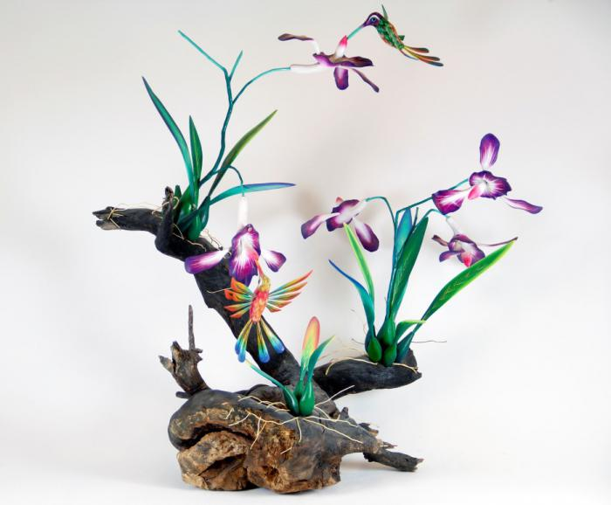
Orchid and Hummingbirds on driftwood base (CA26)

Slide 27
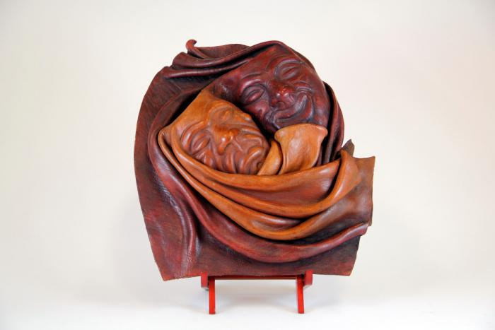
"Good Times / Bad Times" Mask (CA27)

Slide 28
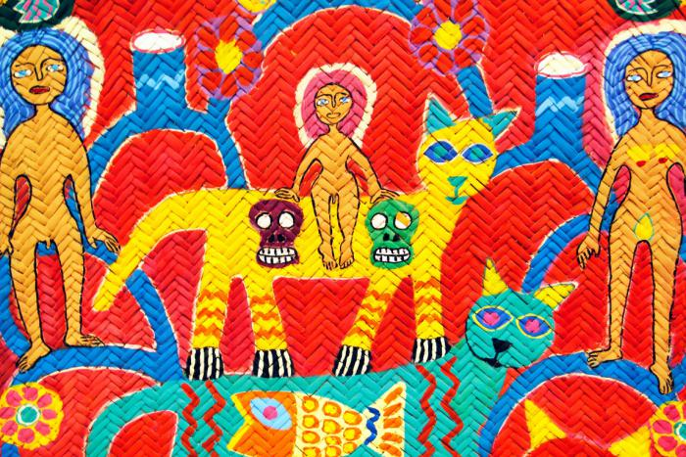
large wall hanging - nude people with cats, birds and serpent (CA28)

Slide 29
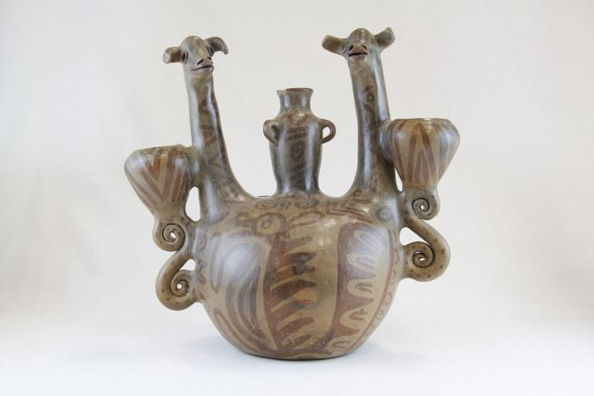
Double Headed Giraffe Candelabra (JO1)

Slide 30
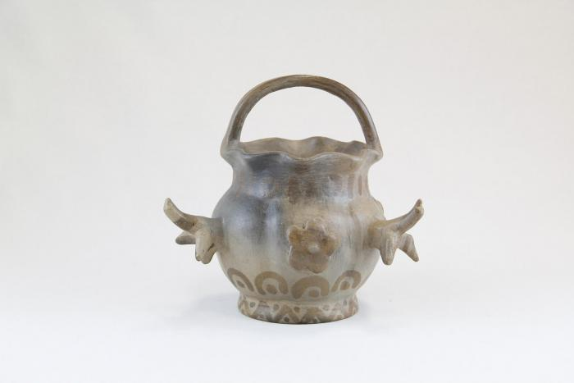
Small Pot with Birds (JO2)

Slide 31
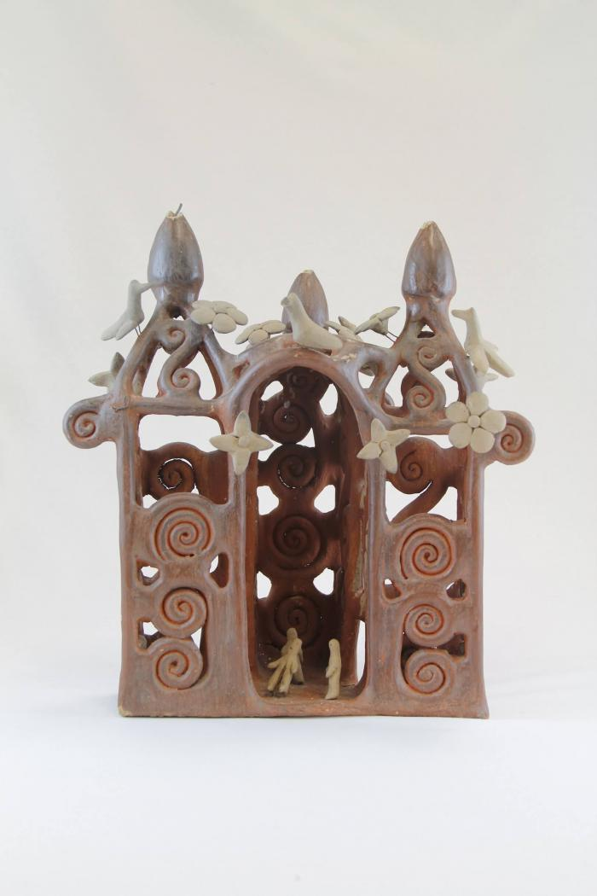
Large Ceramic Church (JO3)

Slide 32
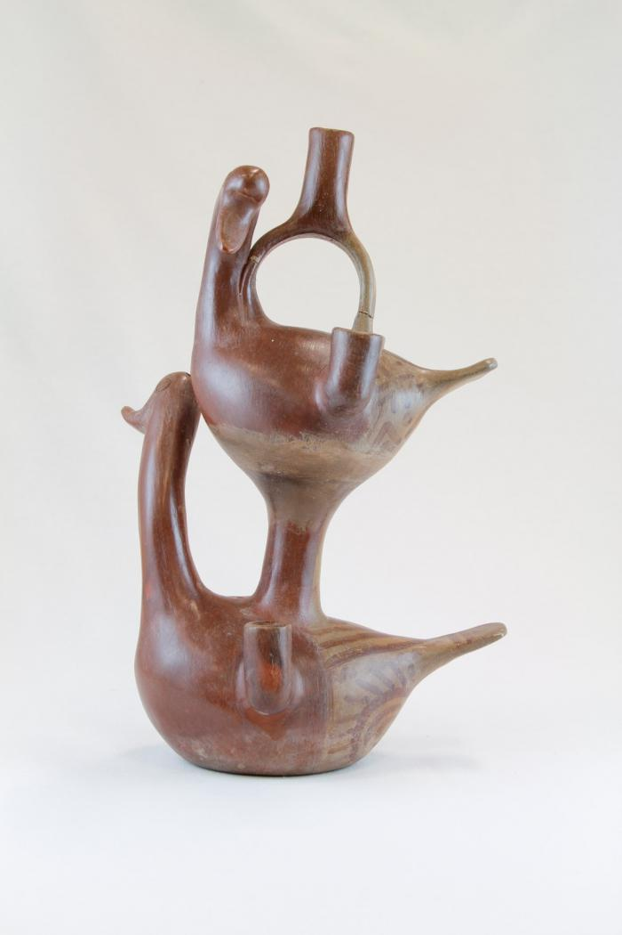
Two Duck Candelabra (JO4)

Slide 33
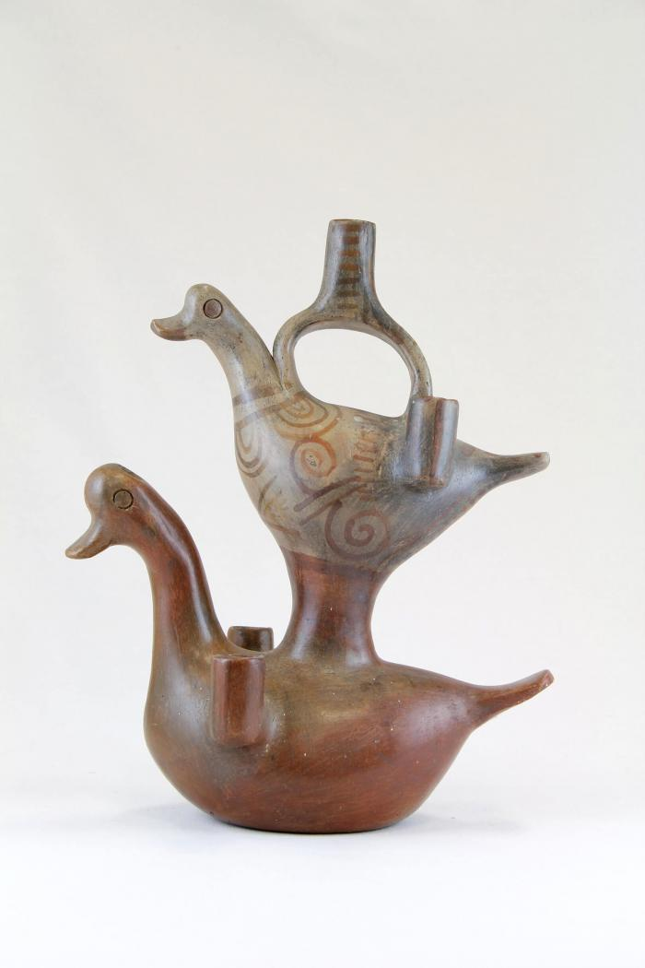
Two Duck Diamond Candelabra (JO5)

Slide 34
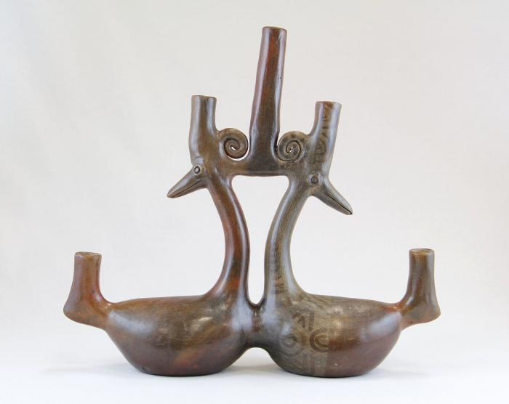
Parallel Ducks Candelabra (JO6)

Slide 35
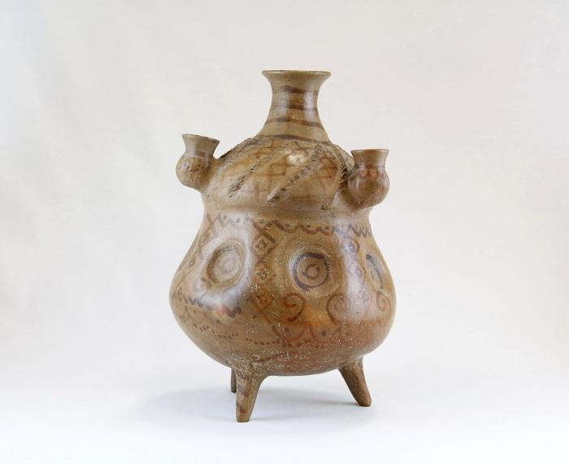
Large Criss Cross Candelabra Pot (JO7)

Slide 36
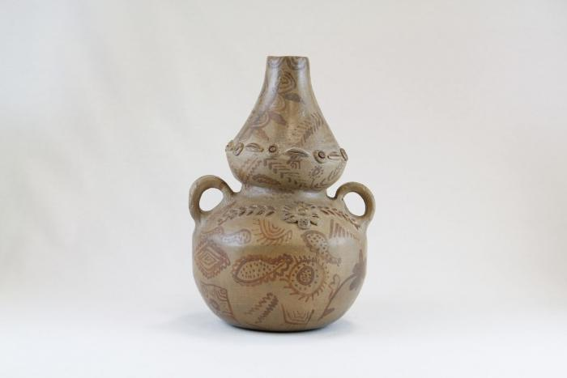
Two Handle Pot with Flowers (JO8)

Slide 37
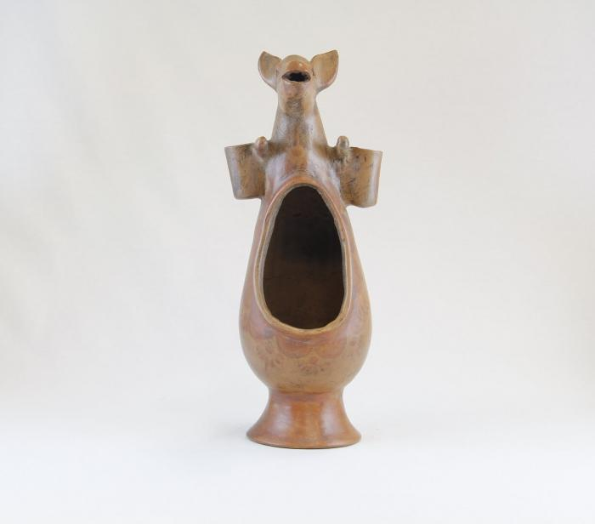
Kangaroo Luminaria (JO9)

Slide 38
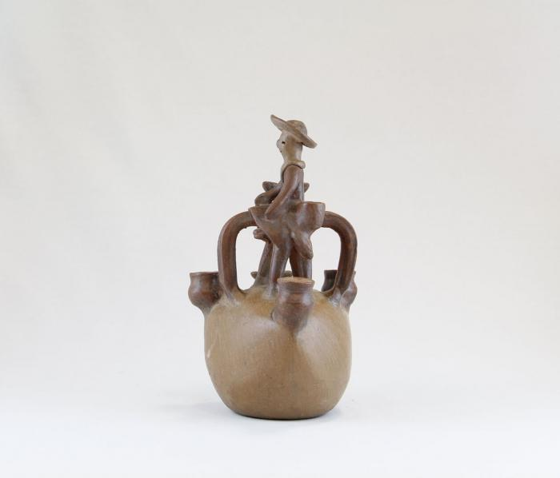
Man on Horse Candelabra (JO10)

Slide 39
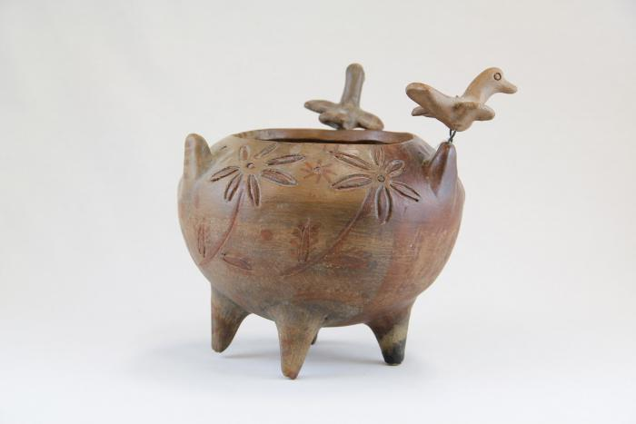
Incised Pot with Three Birds (JO11)

Slide 40
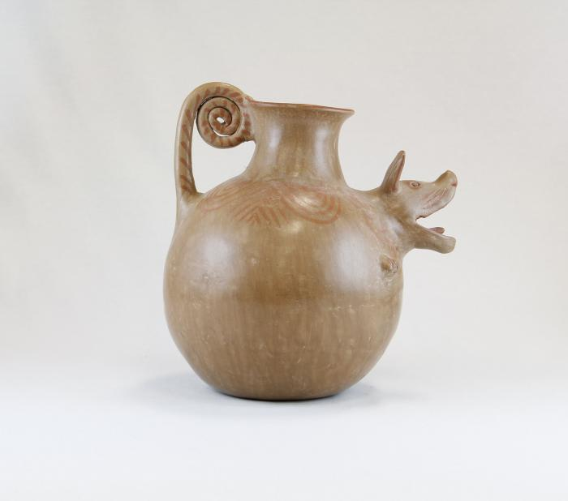
Barking Dog Pot (JO12)

Slide 41
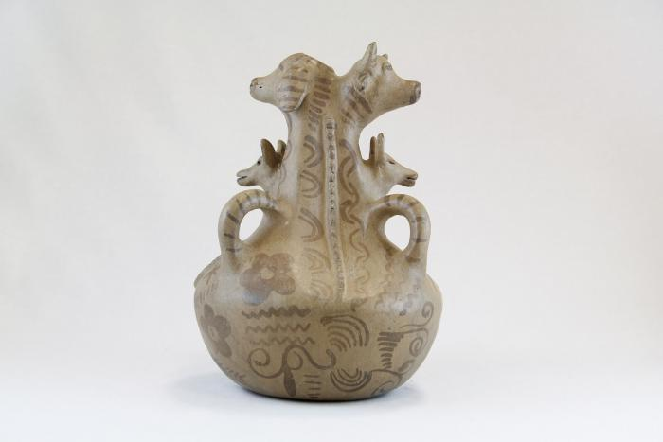
Three Dogs and a Cow Pot (JO13)

Slide 42
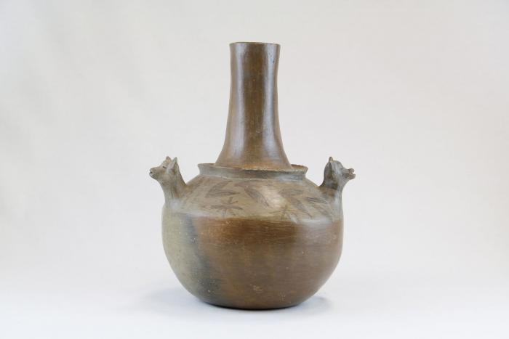
Three Dog Pot (JO14)

Slide 43
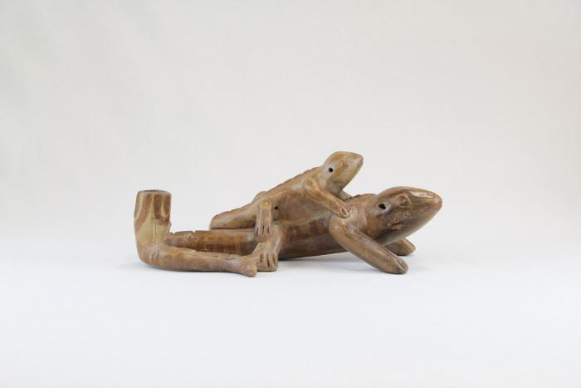
Lizard and Baby Lizard Candle Holder (JO15)

Slide 44
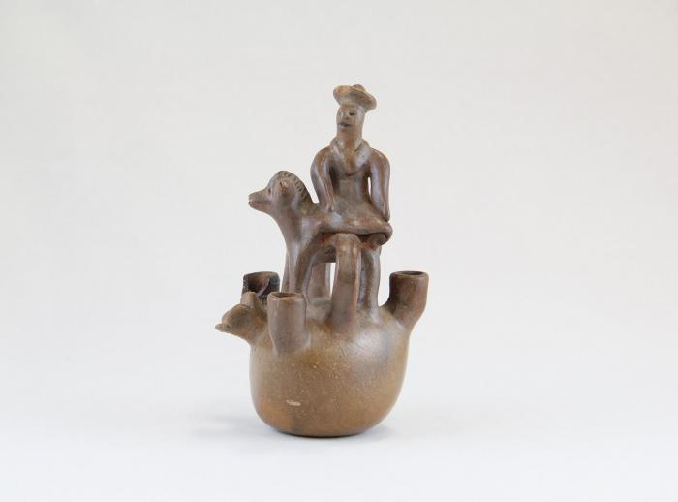
Little Man on Horse Candelabra (JO16)

Slide 45
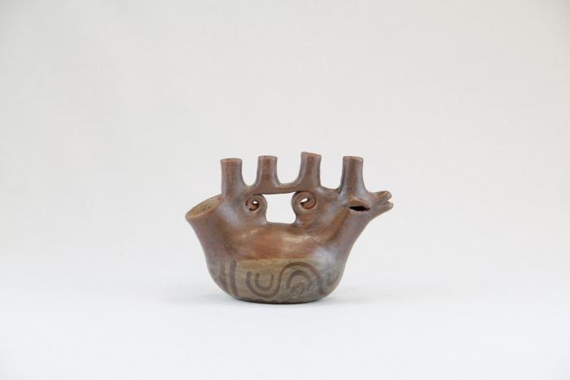
Sitting Bird Candelabra (JO17)

Slide 46
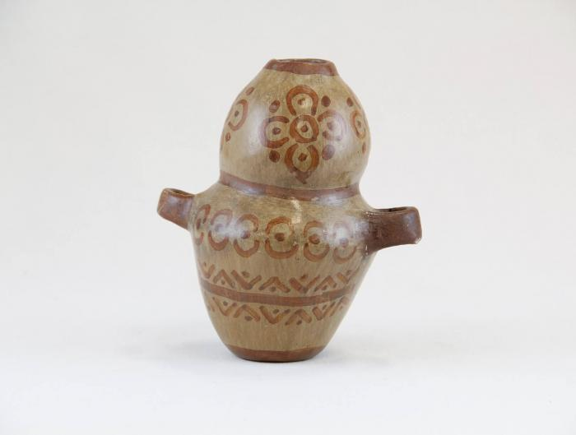
Small Two Handle Vase with Flowers (JO18)

Slide 47
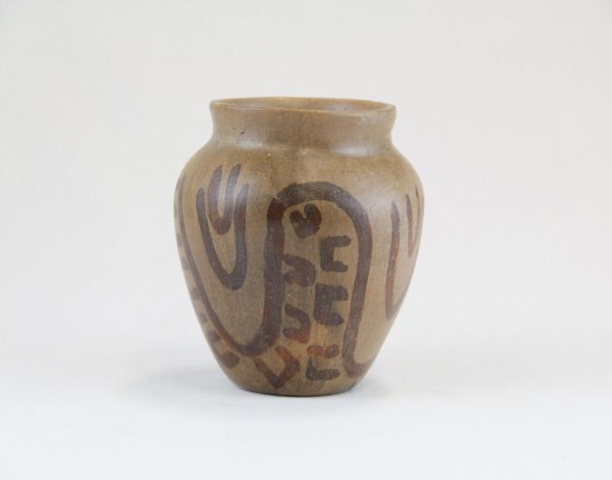
Small Pot with Painted Hand Shapes (JO19)

Slide 48
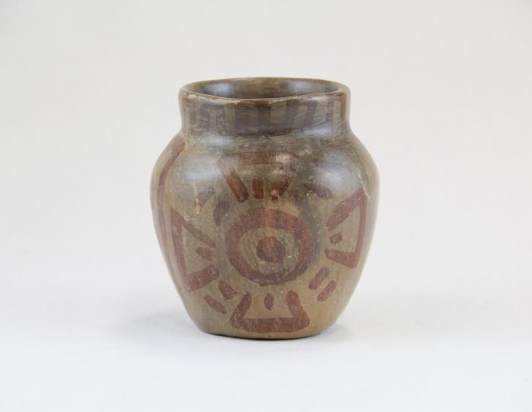
Small Pot with Medallions (JO20)

Slide 49
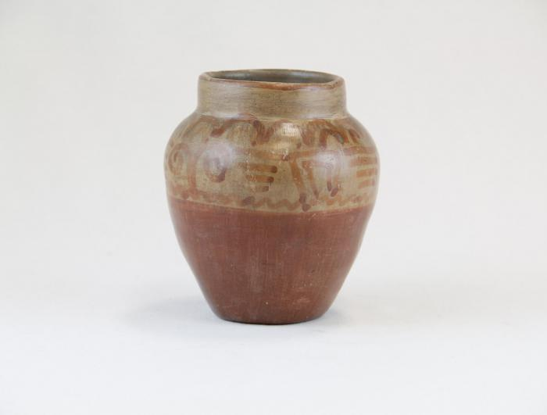
Small Pot with Greco Designs (JO21)

Slide 50
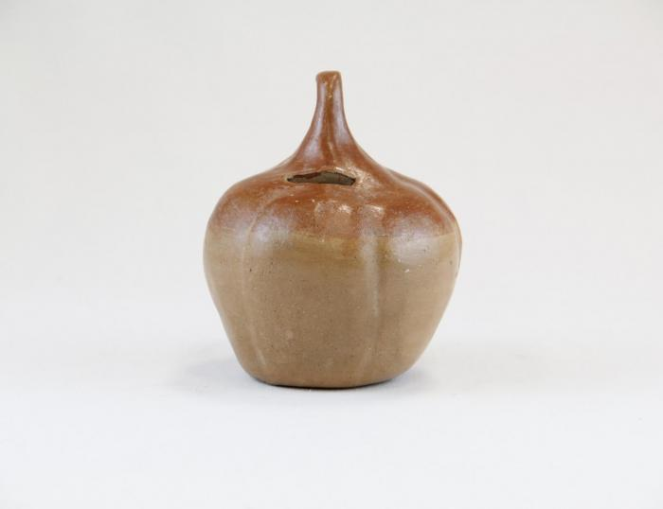
Small Pumpkin Bank (JO22)

Slide 51

Small Pre-Columbian Face Mask (JO23)

Slide 52

Small Pot with Squiggles (JO24)

Slide 53

Bird and Two Baby Birds Candelabra (JO25)

Slide 54

Small Three Candle Candelabra Pot (JO26)

Slide 55

Two Handle Pot (JO27)

Slide 56

Small Bird with Curl-li-que Candle Holder (JO28)

Slide 57

Small Bird with X on its Side Candle Holder (JO29)

Slide 58

Large Two Handle Pot (JO30)

Slide 59

Face and Two Animal Head Candle Holder (JO31)

Slide 60

Small Curl-li-cue Dog Candle Holder (JO32)

Slide 61

Angel Candle Holder (JO33)

Slide 62

Three Squash Pot (JO34)

Slide 63

Lizard Candle Holder (JO35)

Slide 64

Large Pot on Ring Made of Straw (JO36)

Slide 65

Chicken Pot with Man and Dog (JO37)

Slide 66

Fish with Happy Face Candelabra (JO38)

Slide 67

Two Decorated Sitting Ducks Candelabra (JO39)

Slide 68

Small Ceramic Church with Birds (JO40)

Slide 69

Small Angel Bell Candle Holder (1) (JO41)

Slide 70

Small Angel Bell Candle Holder (2) (JO42)

Slide 71

Animal Face Chimenario (JO43)

Slide 72

Small Three Prong Candelabra (JO44)

Slide 73

Two Ducks Five Candle Candelabra (JO45)

Slide 74

Large Three Prong Candelabra (JO46)

Slide 75

Insect Candle Holder (JO47)

Slide 76

Man Sitting on Bull with Birds and Dogs (JO48)

Slide 77

Ceramic Church with Curl-li-cues (Missing Crosses) (JO49)

Slide 78

Large Ceramic Lizard with Painted Lines and Dots (JO50)

Slide 79

Five Stacked Ceramic Animals (JO51)

Slide 80

Big Eared Dog Candle Holder (JO52)

Slide 81

Ceramic Coiled Rattlesnake (JO53)

Slide 82

Large Ceramic Lizard with Painted Triangles (JO54)

Slide 83

Sitting bird with Two Small Birds Candelabra (JO55)

Slide 84

Octopus Candle Holder (JO56)

Slide 85

Ceramic Cart with Wheels (JO57)

Slide 86

Ceramic Nacimiento (Nativity) (18 pieces) (JO58)

Slide 87

Circular "Tree" Candelabra (JO59)

Slide 88

Eight Ceramic Peacocks (JO60)

Slide 89

Man carrying Turkey (VM1)

Slide 90

Muñeca holding Dog (VM2)

Slide 91

Kneeling Muñeca in White and Purple Dress with Carrots and Plate of Carrots (VM3)

Slide 92

Small Clay Table (VM4)

Slide 93

Three Yellow Baskets / Three Pineapples (VM5)

Slide 94

Kneeling Muñeca with Onions and Plate of Onions (VM6)

Slide 95

Kneeling Muñeca in Blue Dress with Carrots and Plate of Carrots (VM7)

Slide 96

Bowl of Fruit (VM8)

Slide 97

Kneeling Muñeca with Pinneapple (VM9)

Slide 98

Standing Muñeca with Onions and Plate of Onions (VM10)

Slide 99

Kneeling Muñeca with Basket (VM11)

Slide 100

Standing Muñeca with Pinneapple (VM12)

Slide 101

Muñeca with Fruit Bowl (VM13)

Slide 102

Muñeca Holding Basket and Lime (VM14)

Slide 103

Police Officer Holding White Object (VM15)

Slide 104

Police Officer (VM16)

Slide 105

Muñeca with Purse (VM17)

Slide 106

Muñeca with Fruit Basket and Onions (VM18)

Slide 107

Face and Birds Candle holder (VM19)

Slide 108

Ducks Candelabra (VM20)

Slide 109

Bird, Fox and Face Candelabra (VM21)

Slide 110

Candelabra with Animals and Flowers (M1001)

Slide 111

Tree of Life on Donkey (M1002)

Slide 112

Angular Vessel (M1003)

Slide 113

Tree of Life Candle Holder (M1004)

Slide 114

12 Piece Nativity Scene (M1005 / 1006)

Slide 115

Circular Wall Sconces with 2 Birds ( 2 Pieces) (M1007)

Slide 116

Flight Into Egypt (M1008)

Slide 117

Cart with Team of Horses (M1009)

Slide 118

Bird Shaped Candelabra (M1010)

Slide 119

Mermaid (M1011)

Slide 120

Two Mice Candle Holder (M1012)

Slide 121

Virgen de la Soledad (Virgin of Solitude) (M1013)

Slide 122

Virgen de los Desamparados (M1014)

Slide 123

Madonna with Child Virgen del Carmen (M1015)

Slide 124

Virgen Madonna with Gold Crown (M1016)

Slide 125

Aguilar Flight into Egypt (4 pieces) (M1017)

Slide 126

Clay Bird (M1018)

Slide 127

Virgen with Sword (M1019)

Slide 128

Oaxacan Aguilar Nativity #1 (12 pieces) (M1020a)

Slide 129

Oaxacan Aguilar Nativity #2 (13 pieces) (M1020b)

Slide 130

Virgen de Guadalupe (M1021)

Slide 131

Black Maiden with Basket (M1023)

Slide 132

Muñeca holding Bowl (M1024)

Slide 133

Black Clay Virgen de la Soledad (M1025)

Slide 134

Black Clay Pitchers (M1026)

Slide 135

Black Clay Flower (M1027)

Slide 136

White and Black Nativity (Nacimiento) (8 pieces) (M1028)

Slide 137

Rabbit Totem (M1029)

Slide 138

White Clay Virgin covered with Flowers (M1030)

Slide 139

Virgen de Guadalupe (M1031)

Slide 140

Tan Clay Pot with Lizards (M1032)

Slide 141

Clay Mermaid Candelabra (M1033)

Slide 142

Clay Muñeca dressed in the style of Isthmus of Tehuantepec (M1034)

Slide 143

Dancer with Two Flower Baskets (M1035)

Slide 144

Rotating Virgin with Nacimiento (M1036)

Slide 145

Dyed Wood Nativity (12 pieces) (M1037)

Slide 146

Wisemen Standing (3 pieces) (M1038)

Slide 147

Three Wood Carved Wiseman riding on Animals (M1039)

Slide 148

Virgin (M1040)

Slide 149

Praying Angel, 1981 (M1041)

Slide 150

Nativity with Corn in Shelter (1 piece) (M1042)

Slide 151

Tonalá Burnished Nativity (11 Pieces) (M1043)

Slide 152

Mexican Nativity (Nacimiento) (10 pieces) (M1055)

Slide 153

Tree of Life Nativity (Nacimiento) Candle Holder (M1056)

Slide 154

Angel with Guitar Candle Holder (M1057)

Slide 155

Nativity (Nacimiento) with Stars Candle Holder (M1059)

Slide 156

Tree of Life Candelabra with Owls (M1061)

Slide 157

Tree of Life Candelabra with Person, Birds, Animals (M1062)

Slide 158

Wood Nativity (12 pieces) (M1063)

Slide 159

Circular Clay Nativity (1 piece) (M1065)

Slide 160

Nepal Nativity (11 pieces) (M1066)

Slide 161

Bolivia Church Scene Nativity (1 of 2) (M1067a)

Slide 162

Bolivia (Bell Scene) Nativity (2 of 2 ) (M1067b)

Slide 163

Native American Nativity (13 pieces) (M1068)

Slide 164

Wales Nativity (3 pieces) (M1070)

Slide 165

Uruguayan Nativity (13 pieces) (M1071)

Slide 166

3 Candle Candelabra Nativity (M1072)

Slide 167

African Nativity (11 pieces) (M1073)

Slide 168

Nativity Bas-Relief Carved from Tree (M1077)

Slide 169

Clay Madonna and Child in Oval Pot (M1084)

Slide 170

Spotted Feline (M1086)

Slide 171

Painted Armadillo (M1088)

Slide 172

Pumpkin-Shaped Pot with 3 Bird Feet (M1092)

Slide 173

Unglazed Clay Pot with Blue Glaze Inside (M1093)

Slide 174

Eskimo Nativity (14 pieces) (M1096)

Slide 175

Peruvian Nativity Retablo (M1100)

Slide 176

Mexico Box Nativity set (Nicho) (9 pieces) (M1103)

Slide 177

Vessel with Face (M1105)

Slide 178

Barro Negro 3 Candle Candelabra (M1109)

Slide 179

Tree Single Candle Holder on clay base with a few people (M1110)

Slide 180

Vessel with Chac Mool (M1111)

Slide 181

Pre-Columbian Reproduction Figure with Skulls on Forehead (M1500)

Slide 182

Clay figure with braided hair (M1502)

Slide 183

Pre-Columbian Figure Reprodiction (M1503)

Slide 184

Reproduction Pre-Columbian Kneeling Warrior (M1511)

Slide 185

Clay Figure holding a Cup (M1515)

Slide 186

Gray Mayan Hut with Figures and Dogs (broken into 9 pieces) (M1519)

Slide 187

Flight into Egypt - Mary on Donkey (M1524)

Slide 188

Clay Nativity (12 pieces) (M1528)

Slide 189

Two Brown Gourds that Open to Nativity (M1547)

Slide 190

Two birds carved from Wood Burls (M1552)

Slide 191

Mary, Joseph and Jesus Standing Together (M1554)

Slide 192

Santo Virgin of Guadalupe (M1555)

Slide 193

Small Nativity on Wood base (M1559)

Slide 194

Peruvian Nativity Plaque (M1570)

Slide 195

Peruvian Nativity (8 pieces) (M1578)

Slide 196

Painted Angel (M1595)

Slide 197

Three Kings (M1603)

Slide 198

Wind, Water, Light (M1604)

Slide 199

Vase San Bartolo (M1605)

Slide 200

Black Clay Candelabra (M1606)

Slide 201
San Bartolo Coyotepec Incised Vase (M1607)

Slide 202

Black Clay Pot (M1608)

Slide 203

Two Navajo Dance Wands (MU3471)

Slide 204

3 Native American Fantasy Snakes (MU3472)

Slide 205

Red, White & Blue Woven Wool Rug (MU3473)

Slide 206

Burnished Clay Bird Pitcher (MU3477)

Slide 207

Burnished Pot from Mata Ortiz, Chihuahua (MU3478)

Slide 208

Zuni Burnished Pot (Cracked & Repaired) (MU3479)

Slide 209

Zuni Terra Cotta Pot with Brown & Red Accents (MU3480)

Slide 210

Casas Grandes Vase (MU3481)

Slide 211

Cream & White Papier Mache Pot (MU3482)

Slide 212

Terra Cotta Bowl with Bird in Center (MU3483)

Slide 213

Painted Particle Board (MU3484)

Slide 214

Black & White Seed Pot with lizards (MU3485)

Slide 215

Black & White Zuni Pot with Tadpole Motif (MU3486)

Slide 216

Clay Black & White Acoma Pot (MU3487)

Slide 217

Small Clay White, Black & Tan Painted Pot (MU3488)

Slide 218

Small Painted Acoma Pot with Lizard Design (MU3489)

Slide 219

Small painted Acoma Pot with Lid & Kokopelli design (MU3490)

Slide 220

Small Painted Clay Turtle (MU3491)

Slide 221

Cochiti Pueblo Ceramic Frog (MU3492)

Slide 222

Small Clay Brown and Tan Painted Pot (MU3493)

Slide 223

Small Clay Painted Pot (MU3494)

Slide 224

Small Clay Brown & Tan Painted Incense Burner with Lizard Design (MU3495)

Slide 225

Small Clay Black & White Painted Bowl with Deer Design (MU3496)

Slide 226

Mexican Clay Pipe Held by Warrior & Crocodile (MU3497)

Slide 227

Small Painted Brown & Black Ceramic Pot (MU3498)

Slide 228

7 Porcupine Quills (MU3499)

Slide 229

Tohona-O’Odham Small Woven Cream & Brown Coil Pot (MU3500)

Slide 230

Tohona-O’Odham Yucca & Devil Claw Round Basket with Rim (MU3501)

Slide 231

Tohono-O’Odham Woven Yucca Round Basket (MU3502)

Slide 232

Tohono-O’Odham Woven Yucca Basket (MU3503)

Slide 233

Tohono-O’Odham Flat, Round Basket with Yucca Flower Pattern (MU3504)

Slide 234

Ojibwe Porcupine Quill and Birch Bark Box (MU3505)

Slide 235

Gourd Doll on Grass Ring Pedestal (MU3506)

Slide 236

Singer Stone Figure Sculpture with Bird Feathers (MU3507)

Slide 237

Kachina Doll (Shaloko) (MU3508)

Slide 238

Kachina Doll (Palhik Mana) (MU3509)

Slide 239

Kachina Doll (MU3510)

Slide 240

Kachina Doll (Chasing Star) (MU3511)

Slide 241

Kachina Doll (Zuni Fire God) (MU3512)

Slide 242

Kachina Doll (Corn Maiden) (MU3513)

Slide 243

Kachina Doll (Palhik Mana) (MU3515)

Slide 244

Kachina Doll (MU3516)

Slide 245

Kachina Doll (Shalako) (MU3517)

Slide 246
Kachina Doll (Ogre Woman) (MU3518)

Slide 247

Kachina Doll (Badger) (MU3519)

Slide 248

Kachina Doll (Hopi - Red Beard Long Hair) (MU3520)

Slide 249

"4th World" Painting (MU3523)

Slide 250

Zuni Shalako Kachina Painting (MU3525)

Slide 251

Sun Father and Snake Painting (MU3526)

Slide 252

Apache Christ (MU3527)

Slide 253

Paper scroll with rendering of mural on the interior walls of a painted kiva in the Southwest area (MU3528)

Slide 254

Initiation Doll (MU1)

Slide 255

Sangoma Doll (MU2)

Slide 256

Ceremonial Doll (MU3)

Slide 257

Isicwoyo Front Apron (MU4)

Slide 258

Small Doll (MU5)

Slide 259

Maiden Doll (MU6)

Slide 260

Inkehli / Headdress (MU7)

Slide 261

Quechua Rag Doll (MU8)

Slide 262

Dancing Women Blanket (MU9)

Slide 263

Dancing Figures Blanket (MU10)

Slide 264

4 Beaded Coasters (MU11)

Slide 265

Brown, Black and White Coaster (MU12)

Slide 266

Storytelling Woman, "Naya" (MU13)

Slide 267

Storytelling Painted Clay Pot (MU14)

Slide 268

Zuni Pot with Lizard in Center (MU15)

Slide 269

Repeated Wave Pot (MU16)

Slide 270

Jar with belt pattern and base (MU17)

Slide 271

Hopi Hemis Kachina (MU18)

Slide 272

Two Wooden Spoons (MU19)

Slide 273

Kachina doll (Hilili) (MU3514)

Slide 274

Kachina Doll (Handprint Racer) (MU3521)

Slide 275

Oil Painting of Kachina Figure Framed in Wood (MU3524)

Slide 276

Abstract Tile #1 (SE1)

Slide 277

Abstract Tile #2 (SE2)

Slide 278

Abstract Tile #3 (SE3)

Slide 279

Abstract Tile #4 (SE4)

Slide 280

Abstract Tile #5 (SE5)

Slide 281

Abstract Tile #6 (SE6)

Slide 282

Abstract Tile #7 (SE7)

Slide 283

Abstract Tile #8 (SE8)

Slide 284

Abstract Tile #9 (SE9)

Slide 285

Abstract Tile #10 (SE10)

Slide 286

Abstract Tile #11 (SE11)

Slide 287

Abstract Tile #12 (SE12)

Slide 288

Abstract Tile #13 (SE13)

Slide 289

Abstract Tile #14 (SE14)

Slide 290

Abstract Tile #15 (SE15)

Slide 291

Abstract Tile #16 (SE16)

Slide 292

Abstract Tile #17 (SE17)

Slide 293

Abstract Tile #18 (SE18)

Slide 294

Abstract Tile #19 (SE19)

Slide 295

Abstract Tile #20 (SE20)

Slide 296

Abstract Tile #21 (SE21)

Slide 297

Abstract Tile #22 (SE22)

Slide 298

Abstract Tile #23 (SE23)

Slide 299

Abstract Tile #24 (SE24)

Slide 300

Abstract Tile #25 (SE25)

Slide 301

Man Holding Pot Cross Legged Tile #1 (SE26)

Slide 302

Man Holding Pot Cross Legged Tile #2 (SE27)

Slide 303

Man Holding Pot Cross Legged Tile #3 (SE28)

Slide 304

Man Holding Pot Cross Legged Tile #4 (SE29)

Slide 305

Man Holding Pot Cross Legged Tile #5 (SE30)

Slide 306

Man Holding Pot Cross Legged Tile #6 (SE31)

Slide 307

Man Holding Pot Cross Legged Tile #7 (SE32)

Slide 308

Man Holding Pot Cross Legged Tile #8 (SE33)

Slide 309

MesoAmerican Head Tile #1 (SE34)

Slide 310

MesoAmerican Head Tile #2 (SE35)

Slide 311

MesoAmerican Head Tile #3 (SE36)

Slide 312

MesoAmerican Head Tile #4 (SE37)

Slide 313

MesoAmerican Head Tile #5 (SE38)

Slide 314

MesoAmerican Head Tile #6 (SE39)

Slide 315

MesoAmerican Head Tile #7 (SE40)

Slide 316

MesoAmerican Head Tile #8 (SE41)

Slide 317

MesoAmerican Head Tile #9 (SE42)

Slide 318

MesoAmerican Head Tile #10 (SE43)

Slide 319

MesoAmerican Head Tile #11 (SE44)

Slide 320

MesoAmerican Head Tile #12 (SE45)

Slide 321

MesoAmerican Head Tile #13 (SE46)

Slide 322

MesoAmerican Head Tile #14 (SE47)

Slide 323

MesoAmerican Head Tile #15 (SE48)

Slide 324

Laying Man with Dog (SE49)

Slide 325

Laying Woman with Cats (SE50)

Slide 326

Skull Candlesticks (EH1)

Slide 327

Skeleton Couple (EH2)

Slide 328

Catrina (EH3)

Slide 329

Face Jug (EH4)

Slide 330

Ceramic Chiva Bus (EH5)

Slide 331

Skeleton Riding Bicycle (EH6)

Slide 332

Zimbabwean Quilt (EH7)

Slide 333

Peruvian Chancay Birthing Scene (EH8)

Slide 334

Angel (EH9)

Slide 335

Three Minstrels (EH10)

Slide 336

Metal Figures attached to Bone (EH11)

Slide 337

Two Skeleton Drummers (EH12)

Slide 338

"Visions" Bolo Tie (EH13)

Slide 339

Guatemalan Horseshoe Wall Art (EH14)

Slide 340

White Eagle (EH15)

Slide 341

Jumex Ceramic Heart with Nails (EH16)

Slide 342

Wolf Head on Metal Band (EH17)

Slide 343

Sterling Silver Sculpture of Man playing Violin, made in Israel (EH18)

Slide 344

"Sisters in Progress", Painted Rock Paperweight (EH19)

Slide 345

Woman Riding Elephant in Glass Case (EH20)

Slide 346

George Washington (EH21)

Slide 347

John the Baptist, with Yellow Haired Angels (EH22)

Slide 348

Woman Guitarist (EH23)

Slide 349

Moses Strikes the Rock at Kadesh (EH24)

Slide 350

Three Sitting Dogs Playing Cards on Green Plank (EH25)

Slide 351

Cowboy Alligator (EH26)

Slide 352

Large Skeleton with Rotating Arms and Legs (EH27)

Slide 353

Wood Skeleton Armoire (EH28)

Slide 354

Two Carved Wood Indoor Scenes (EH29)

Slide 355

Howard Finster Eagle and Poem on Board (EH30)

Slide 356

Tiger Table (EH31)

Slide 357

Woman and Child (EH32)

Slide 358

Don Pedrito Jaramillo with chipped nose on blue base (RE1)

Slide 359
Don Pedrito Jaramillo with criss cross base and chair (RE2)

Slide 360
Don Pedrito Jaramillo white and dark grey hair seated in orange chair (RE3)

Slide 361

Peruvian Church with Market Scene
(SE51)

Slide 362

Peruvian Church Candle Holder and Luminary
(SE52)

Slide 363

Peruvian Church with Multiple Small Figures (SE53)

Slide 364

Iatmul Wood Figure
(SE54)

Slide 365

Tigre Mask (PR1)

Slide 366

Bat Mask (PR2)

Slide 367

Devil Mask with Two Snakes (PR3)

Slide 368

Mermaid Mask (PR4)

Slide 369

Hermit Mask (PR5)

Slide 370

Goat Mask (PR6)

Slide 371

Mermaid and Bird Mask (PR7)

Slide 372

Old Man Mask (Viejo) (PR8)

Slide 373

Viejito Mask (PR9)

Slide 374

Bat and Mermaid Mask (PR10)

Slide 375

Tin Mask (PR11)

Slide 376

El Barbón Mask (PR12)

Slide 377

Nagual Mask (PR13)

Slide 378

Wood Carved Leopard Mask (PR14)

Slide 379

Diablo-Calavera (Devil-Skull) Mask (PR15)

Slide 380

Leather Mask (PR16)

Slide 381

Carnival Jester Mask (PR17)

Slide 382

Moro Pasion Mask (PR18)

Slide 383

Round Ceramic Mask (PR19)

Slide 384

Unglazed Ocumicho Mask (PR20)

Slide 385

Blue Devil Mask (PR21)

Slide 386

Straw or Palm Mask (PR22)

Slide 387

Donkey Mask (PR23)

Slide 388

Devil Mask (PR24)

Slide 389

Chané Jaguar Mask (PR25)

Slide 390

Moon and Star Ceramic Mask / Wall Hanging (PR26)

Slide 391

Stars Ceramic Mask / Wall Hanging (PR27)

Slide 392

Venezuelan Tribal Mask (PR28)

Slide 393

Piaroa Kohue Mask (PR29)

Slide 394

Ecuadorian Monkey Mask (PR30)

Slide 395

Puerto Rican Vejigantes Mask (PR31)

Slide 396

Puerto Rican Vejigantes Mask (PR32)

Slide 397

Ranga Mask (PR33)

Slide 398

Indonesian Barong Mask (PR34)

Slide 399

Indonesian Barong Mask (PR35)

Slide 400

Balinese Long Mask with Lizards (PR36)

Slide 401

Ganesha mask (PR37)

Slide 402

Hill Tribe Thai Mask #1 (PR38)

Slide 403

Hill Tribe Thai Mask #2 (PR39)

Slide 404

Sepik River Mask (PR40)

Slide 405

Porcelain Foo Dog Wall Hanging (PR41)

Slide 406

Jero Luh Mask (PR42)

Slide 407

Namahage Mask (PR43)

Slide 408

Meng Liang, white opera mask (PR44)

Slide 409

Okina Mask (PR45)

Slide 410

Gigaku or Tengu mask (PR46)

Slide 411

Okame (Otafuku) Mask (PR47)

Slide 412

Nojang (monk) mask (PR48)

Slide 413

Fang Mask from Ghana (PR49)

Slide 414

Carved Wood Mask, Possibly African (PR50)

Slide 415

Coconut Man's Head Mask (PR51)

Slide 416

Dan Tribe Mask (PR52)

Slide 417

Brazilian Gemstone Mask (PR53)

Slide 418

Rectangular Wood Mask (PR54)

Slide 419

Maasai mask (PR55)

Slide 420

Ashanti mask, from the Akan people group in Ghana (PR56)

Slide 421

Fanged Mask (PR57)

Slide 422

Brazilian Carranca Figurehead (PR58)

Slide 423

Kifwebe Ceremonial Mask (PR59)

Slide 424

Sombreria Market Scene (MC1)

Slide 425

Grocery Store Scene "Tienda Amelia" (MC2)

Slide 426

"Artesanias Ecuador" Market Scene (MC3)

Slide 427

Grocery Store Scene "Tienda Penelope" (MC4)

Slide 428

Christ on Cross with Angels Wood Wall Hanging (MC5)

Slide 429

Topsy Turvy Doll (MC6)

Slide 430

Chancay Doll, Mother and Child (MC7)

Slide 431

Venezuelan Piranha Mask (MC8)

Slide 432

Wooden Mask, Stained Pink (MC9)

Slide 433

Indonesian Wayang Shadow Puppet (MC10)

Slide 434

Yagua Mask (MC11)

Slide 435

Monkey Mask (MC12)

Slide 436

Guro Mask (MC13)

Slide 437

Ebony Carved Figures from Makonde Tribe (MC14)

Slide 438

Long Forehead Face Mask (MC15)

Slide 439

Ebony Carved Woman with Fabric Dress, Metal Neck Wrap, Beaded Earrings (MC16)

Slide 440

Mapula (Mother of Rain) Flower and Lion Cloth (MC17)

Slide 441

Small Wood Carved Figure with Wire Earrings and Staff (MC18)

Slide 442

Ashanti Small Mask (MC19)

Slide 443

Beaded Metal Dragon (MC20)

Slide 444

Papua New Guinea Tribal Shield (SE55)

Slide 445

Kilim Rug (SE56)

Slide 446

Agave Plant with Virgin of Guadalupe (SH1)

Slide 447

Agave Plant with Virgin of Guadalupe (SH2)

Slide 448

Angel (SH3)

Slide 449

Angel (SH4)

Slide 450

Angel (SH5)

Slide 451

Angel (SH6)

Slide 452

Angel holding Book (SH7)

Slide 453

Angel holding Dove (SH8)

Slide 454

Angel holding Flowers (SH9)

Slide 455

Angel kneeling (SH10)

Slide 456

Angel playing Guitar (SH11)

Slide 457

Angel playing Harp (SH12)

Slide 458

Angel with Purple and Red Flower (SH13)

Slide 459

Angel with Red and Yellow Flower (SH14)

Slide 460

Angel with Small Angel (SH15)

Slide 461

Animal Band (SH16)

Slide 462

Animal Bell (SH17)

Slide 463

Animal playing an Electric Guitar (SH18)

Slide 464

Armadillo (SH19)

Slide 465

Armadillo (SH20)

Slide 466

Aztec / Mayan holding Woman (SH21)

Slide 467

Bird Cage with Tree (SH22)

Slide 468

Black and Red Vase (SH23)

Slide 469

Black Green and Red Vase (SH24)

Slide 470

Black Vase (SH25)

Slide 471

Black Vase (SH26)

Slide 472

Black Vase (SH27)

Slide 473

Black Vase (SH28)

Slide 474

Mata Ortiz Black Vase (SH29)

Slide 475

Black Vase (SH30)

Slide 476

Black Vase (SH31)

Slide 477

Blue Animal (SH32)

Slide 478

Blue Goat (SH33)

Slide 479

Blue Rattle Snake (SH34)

Slide 480

Bowl (SH35)

Slide 481

Tarahumara Indian Baskets (SH36)

Slide 482

Boy Angel playing Harp (SH37)

Slide 483

Cactus (SH38)

Slide 484

Cactus blooming Pink Flower (SH39)

Slide 485

Cactus with Three Virgins (SH40)

Slide 486

Cart with Cows (SH41)

Slide 487

Celebration Belt (SH42)

Slide 488

Centaur playing Violin (SH43)

Slide 489

Chicken with Chicks (SH44)

Slide 490

Cows with Cart (SH45)

Slide 491

Crocodile (SH46)

Slide 492

Crucification (SH47)

Slide 493

Danza de la Pluma (SH48)

Slide 494

Danza de la Pluma (SH49)

Slide 495

Dancing Man with Bird (SH50)

Slide 496

Torito Dancer with Fireworks (SH51)

Slide 497

Dancing Man with Cow Fireworks (SH52)

Slide 498

Decorated Cows with Cart (SH53)

Slide 499

Desert Scene (SH54)

Slide 500

Dog playing Guitar (SH55)

Slide 501

Dragon (SH56)

Slide 502

Dragon (SH57)

Slide 503

Dragon (SH58)

Slide 504

Drum (SH59)

Slide 505

Elephant (SH60)

Slide 506

Farmers on Parade (SH61)

Slide 507

Makonde Shetani Sculpture (SH62)

Slide 508

Firework Castle (SH63)

Slide 509

Firework Dancing man (SH64)

Slide 510

Frog Pitcher Set (SH65)

Slide 511

Garuda (SH66)

Slide 512

Giant Vase (SH67)

Slide 513

Goat with Guitar (SH68)

Slide 514

Green Masked Dancer (SH69)

Slide 515

Hookah (SH70)

Slide 516

Deer Alebrije (SH71)

Slide 517

Humming Bird (SH72)

Slide 518

Kneeling Angel (SH73)

Slide 519

La Serina playing Horn (SH74)

Slide 520

La Virgen de San Juan de los Lagos (SH75)

Slide 521

La Virgen del Apocalipsis (SH76)

Slide 522

Women selling Goods (SH77)

Slide 523

Woman with White Flowers (SH78)

Slide 524

Tigrada Parade Cornhusk Doll (SH79)

Slide 525

Tigrada Parade Cornhusk Doll (SH80)

Slide 526

Lion (SH81)

Slide 527

Lizard (SH82)

Slide 528

Lizard (SH83)

Slide 529

Lizard (SH84)

Slide 530

Longhaired Maiden (SH85)

Slide 531

Man displaying Virgin (SH86)

Slide 532

Man riding with Animals (SH87)

Slide 533

Man with Maracas (SH88)

Slide 534

Man with Whip (SH89)

Slide 535

Many Faces of Mata Ortiz (SH90)

Slide 536

Mermaid with Frog (SH91)

Slide 537

Mermaids on Beach (SH92)

Slide 538

Monk with Bird (SH93)

Slide 539

Mother Skunk (SH94)

Slide 540

Multi Color Bikini Cat Band (SH95)

Slide 541

Oaxacan Plume Dancer (SH96)

Slide 542

Ethiopian Canoe Gambella Basket (SH97)

Slide 543

Palm Tree with Feeding Bird (SH98)

Slide 544

Pink Flower (SH99)

Slide 545

Purple Angel holding Flower (SH100)

Slide 546

Rabbit (SH101)

Slide 547

Rat Woodcarving (SH102)

Slide 548

Red Green and Silver Vase (SH103)

Slide 549

Red Vase (SH104)

Slide 550

Rooster (SH105)

Slide 551

Saint Francis of Assisi (SH106)

Slide 552

Saint Michael (SH107)

Slide 553

Serpent Pottery Vessel (SH108)

Slide 554

Skeleton Band (SH109)

Slide 555

Small Red Vase (SH110)

Slide 556

Small Red Vase (SH111)

Slide 557

Tea Pot (SH112)

Slide 558

Toucan (SH113)

Slide 559

Wood Carved Turtles (SH114)

Slide 560

Vase (SH115)

Slide 561

Virgen de la Soledad (SH116)

Slide 562

Virgin de Guadalupe (SH117)

Slide 563

Virgin de Guadalupe (SH118)

Slide 564

Virgin de Guadalupe (SH119)

Slide 565

Virgin de Guadalupe (SH120)

Slide 566

Virgin de Guadalupe (SH121)

Slide 567

Virgin de la Soledad (SH122)

Slide 568

Virgin De Rosary (SH123)

Slide 569

Virgin Mary (SH124)

Slide 570

Virgin Mary (SH125)

Slide 571

Virgin Mary with Man kneeling (SH126)

Slide 572

Virgin of Guadalupe (SH127)

Slide 573

Virgin of Guadalupe Cactus (SH128)

Slide 574

Chalupa Boat (SH129)

Slide 575

Woman making a Rug (SH130)

Slide 576

Polar bear with Cub (AC1)

Slide 577

Boy Fishing (AC2)

Slide 578

Humpback whale (AC3)

Slide 579

Spirit of the Mountain (AC4)

Slide 580

Two-Headed Statue (AC5)

Slide 581

Caribou Skin Mask with Black Ink Tattoos (AC6)

Slide 582

Stages of Marriage Bracelet (AC7)

Slide 583

Eagle and Fish (AC8)

Slide 584

Miniature Mountain Spirit Mask (AC9)

Slide 585

Loon Birds Earrings (AC10)

Slide 586

Kayak Necklace (AC11)

Slide 587

Ivory Swan Pendant (AC12)

Slide 588

Lucky Halibut (AC13)

Slide 589

Round Earrings (AC14)

Slide 590

Rhombus Earrings (AC15)

Slide 591

Beluga Whale (AC16)

Slide 592

Baby Seal (AC17)

Slide 593

Baby Polar Bear (AC18)

Slide 594

Bird Pendant (AC19)

Slide 595

Button Face Native Doll (AC20)

Slide 596

Yupik Bone Doll (AC21)

Slide 597

Yupik Bone Doll (AC22)

Slide 598

Chevak Cup'ik Doll holding Berries (AC23)

Slide 599

Chevak Cup'ik Doll (AC24)

Slide 600

Impressioned Silver Mask (SHA1)

Slide 601

Shipibo Ceramic Olla (SHA2)

Slide 602

Shipibo Ceramic Bowl (SHA3)

Slide 603

Shipibo Ceramic Bowl (SHA4)

Slide 604

Shipibo Ceramic Bowl (SHA5)

Slide 605

Pucara Ceramic Bull (SHA6)

Slide 606

Carved Wooden Bowl (SHA7)

Slide 607

Pisco Figural Bottle (SHA8)

Slide 608

Pisco Figural Bottle (SHA9)

Slide 609

Shipibo Woven Bag (SHA10)

Slide 610

Shipibo Bracelet (SHA11)

Slide 611

Shipibo Seed Necklace (SHA12)

Slide 612

Shipibo Comb (SHA13)

Slide 613

Shipibo Dart Quiver with Goard (SHA14)

Slide 614

Shipibo Dart Quiver with Jaw Bone (SHA15)

Slide 615

Shipibo Blowgun (SHA16)

Slide 616

Shipibo Blowgun (damaged) (SHA17)

Slide 617

Shipibo Ceremonial Club (SHA18)

Slide 618

Shipibo Paddle (SHA19)

Slide 619

Shipibo Bow (SHA20)

Slide 620

Shipibo Fishing Arrows (SHA21)

Slide 621

Shipibo Grass Clothing (SHA22)

Slide 622

"Land Carer" (PE1)

Slide 623

"Mother Earth" (PE2)

Slide 624

Bird House and Flowers (HA1)

Slide 625

Man smoking pipe with cat and flowers (HA2)

Slide 626

Two girls and chickens (HA3)

Slide 627

Cat sits on chair surrounded by flowers (HA4)

Slide 628

Big Jaguar Wrap Skirt (AFFA1)

Slide 629

Blue Hearts Huipil (AFFA2)

Slide 630

Chiapas Magdalena Huipil (AFFA3)

Slide 631

Chiapas Tenejapa Huipil (AFFA4)

Slide 632

Chiapas Tenejapa Shawl (AFFA5)

Slide 633

Chiapas Zinacantan Huipil (AFFA6)

Slide 634

Chiapas Zinacantan Serape (AFFA7)

Slide 635

Chichicastenango Flowers Huipil (AFFA8)

Slide 636

Chichicastenango Huipil (AFFA9)

Slide 637

Colotenango Huipil (AFFA10)

Slide 638

Jalapa de Diaz Oaxaca Multicolored Bird and Flower Huipil (AFFA11)

Slide 639

Joyabaj Huipil (AFFA12)

Slide 640

Market Apron (AFFA13)

Slide 641

Bolivian Men's Poncho (AFFA14)

Slide 642

Oaxacan Amuzgo Huipil (AFFA15)

Slide 643

Oaxacan Huautla Huipil and Falda (AFFA16)

Slide 644

Chichicastenango Huipil with gold threading (AFFA17)

Slide 645

Patzún Huipil 1 (AFFA18)

Slide 646

Patzún Huipil 2 (AFFA19)

Slide 647

Pink Belt (AFFA20)

Slide 648

San Antonio Aguas Calientes Huipil (AFFA21)

Slide 649

San Juan Sacatepequez Faja (AFFA22)

Slide 650

San Lucas Toliman Huipil (AFFA23)

Slide 651

Santa Maria Nebaj Huipil (AFFA24)

Slide 652

Santiago Atitlán Bird Huipil (AFFA25)

Slide 653

Santiago Atitlán Bird Huipil #2 (AFFA26)

Slide 654

Santiago Atitlán Turkey Huipil (AFFA27)

Slide 655

Trique Huipil (AFFA28)

Slide 656

Two Peacocks Black and White Dress (AFFA29)

Slide 657

White Campesina Blouse (AFFA30)

Slide 658

White Skirt with Woman and Horse Scene on Edge (AFFA31)

Slide 659

Ecuadorian Women's Outfit (AFFA32)

Slide 660

Catrina (ME1)

Slide 661

Group of Día de los Muertos Skeletons (GR1)

Slide 662

"Elephant" Carved Dried Gourd with Lid (YO1)

Slide 663

"Zulu" Carved Dried Gourd (YO2)

Slide 664

Beaded Bracelets (YO3)

Slide 665

Beaded Wood Ndebele Brush (YO4)

Slide 666
Beaded Wood Ndebele Knife (YO5)

Slide 667

Carved Wood Ladle (YO6)

Slide 668

Pasiking (Rattan Backpack) (YO7)

Slide 669

Beaded Fly Whisk (YO8)

Slide 670

Tzintzuntzan Boat Women (YO9)

Slide 671

Turkish Talisman with Evil Eye (HU1)

Slide 672

Turkmen Child Tunic (HU2)

Slide 673

Turkish Karagöz Shadow Puppets (HU5)

Slide 674

Papua New Guinea Shell Necklace (SE57)

Slide 675

Andean Aguayo Blanket (WI1)

Slide 676

Guatemalan San Lucas Tolimán Huipil (WI2)

Slide 677

Guatemalan Tablecloth with Quetzales (WI3)

Slide 678

Wall Hanging from Chiapas (WI4)

Slide 679

Rebozo from Totonicapan, Guatemala (WI5)

Slide 680

Peruvian Manta (WI6)

Slide 681

Vintage table runner from San Martin Jlitepeque, Guatemala (WI7)

Slide 682

Guatemalan Huipil with Bird and Rooster Pattern (WI8)

Slide 683

Guatemalan Rebozo (WI9)

Slide 684

Guatemalan Patchwork Skirt (WI10)

Slide 685

Blue and Yellow Guatemalan Belt (WI11)

Slide 686

Guatemalan Purple Belt with Diagonal Threaded Rectangles (WI12)

Slide 687

Guatemalan Striped Faja (WI13)

Slide 688

Thin Green Patterned Guatemalan Cinta (WI14)

Slide 689

Guatemalan Short Red Striped Belt (WI15)

Slide 690

Turquoise and Yellow Faja (WI16)

Slide 691

Guatemalan Belt with Silver Circle Conchos (WI17)

Slide 692

San Antonio Aguas Calientes Faja (WI18)

Slide 693

Guatemalan Multicolored Faja with Yellow Line (WI19)

Slide 694

Purple and White Guatemalan Faja (WI20)

Slide 695

Stripe Belt (WI21)

Slide 696

Zunil Cinta (WI22)

Slide 697

Bolivian Manta (WI24)

Slide 698

Tibetan Yak Mat (WI25)

Slide 699

Toucan and Parrot Whistles (WI26)

Slide 700

Voodoo Doll (WI27)

Slide 701

Ivory and Metal Sculptures (WI28)

Slide 702

Tibetan Thangka (WI29)

Slide 703

Krishna and Three Wives Fabric Painting (Pichhwai) (WI30)

Slide 704

Chinese Carved Lacquer Vases (WI31)

Slide 705

Yangban Mask (WI32)

Slide 706

Turkmen Child Tunic (HU3)

Slide 707

Santa Maria Nebaj Rebozo (HU4)

Slide 708

Repeating Flower Cinta (WI23)

Slide 709

Egyptian Rug (AC25)

Slide 710

Ethiopian Meqenet (AC26)

Slide 711

Ethiopian Gabi (AC27)

Slide 712

Senegalese Wedding Fabric Strip (AC28)

Slide 713

Mud Cloth from Benin (AC29)

Slide 714

Los Diablitos Toman la Presidencia (The Little Devils Take the
Presidency) (LI1)

Slide 715

Vollis Simpson Whirligig (HN1)

Slide 716

Three Figures (DA1)

Slide 717

Akua'ba (DE1)

Slide 718

Ekeko Good Luck Charm (FR1)

Slide 719

Bolivian Cholita Doll (FR2)

Slide 720

Bolivian Aymara Blanket (FR3)

Slide 721

Woven Bamboo Conical Hat (FR4)

Slide 722

Bhutanese Kira (FR5)

Slide 723

Bhutan Belt (Kera) (FR6)

Slide 724

Bhutanese Embroidered Kira (FR7)

Slide 725

Cameroon Double Bell (FR8)

Slide 726

Inuit Stone Carved Bear (FR9)

Slide 727

Chinese Lotus Shoes (FR10)

Slide 728

Chinese Embroidered Headband (FR11)

Slide 729

Chinese Children's Tiger Hat (FR12)

Slide 730

Chinese Tiger Hat (FR13)

Slide 731

Jade Horse Incense Burner (FR14)

Slide 732

Lion Incense Holder (FR15)

Slide 733

Chinese Pose Doll (FR16)

Slide 734

Chinese Horse Bells (FR17)

Slide 735

Chinese Traditional Straw Sandals (FR18)

Slide 736

Chinese Wood Carved Panel (FR19)

Slide 737

Tibetan Miniature Village (FR20)

Slide 738

Tibetan Monk's Hat (FR21)

Slide 739

Tibetan Apron (FR22)

Slide 740

Tibetan Embroidered Silk Hat (FR23)

Slide 741

Tibetan Buddhist Amulet (FR24)

Slide 742

Tibetan Oil Lamp (FR25)

Slide 743

Tibetan Metal Fastener (FR26)

Slide 744

Tibetan Copper Pitcher (FR27)

Slide 745

Tibetan Prayer Wheels (FR28)

Slide 746

Tibetan Gau (FR29)

Slide 747

Tibetan Turquoise Pendant (FR30)

Slide 748

Tibetan Bowl (FR31)

Slide 749

Tibetan Camels Print (FR32)

Slide 750

Tibetan Wood Printing Block (FR33)

Slide 751

Tibetan Six Panel Printing Block (FR34)

Slide 752

Lega Hat (FR35)

Slide 753

Kuba Cloth (FR36)

Slide 754

Congo Kuba Table Cloth (FR37)

Slide 755

Kuba Raffia Cloth (FR38)

Slide 756

Kuba Cloth Checker Pattern (FR39)

Slide 757

Ecuadorian Straw Dolls (FR40)

Slide 758

Ghana Kente Cloth (FR41)

Slide 759

Guatemalan Chicken Van (FR42)

Slide 760

Guatemalan Wooden Bull Mask (FR43)

Slide 761

Red and Black Faja (FR44)

Slide 762

Chichicastenango Faja (FR45)

Slide 763

Faja (FR46)

Slide 764

Guatemalan Sashes (Fajas) (FR47)

Slide 765

Painted Cofre Box by Otzoy (FR48)

Slide 766

Painted Cofre by Filiberto Simon (FR49)

Slide 767

Guatemalan Chicken Candle Holder (FR50)

Slide 768

Guatemalan Rooster (FR51)

Slide 769

Calabash Gourd Shakers (FR52)

Slide 770

Indian Hindu Painting (FR53)

Slide 771

Lacquer Box from Kashmir (FR54)

Slide 772

Mortar and Pestle (FR55)

Slide 773

Indian Stamp with Elephant (FR56)

Slide 774

Indian Parcel-Gilt Silver Comb (FR57)

Slide 775

Indian Horseshoes (FR58)

Slide 776

Brass Jewelry Mold (FR59)

Slide 777

Rabari Carrying Ring (Indhoni) (FR60)

Slide 778

Rabari Cap (FR61)

Slide 779

Rabari Shisha Embroidered Cloth (FR62)

Slide 780

Rabari Hat with Mirrors (FR63)

Slide 781

Stone Carved Horse Sculpture (FR64)

Slide 782

Banjara Textile (FR65)

Slide 783

Gujarat Textile (FR66)

Slide 784

Banjara Wall Hanging (Toran) (FR67)

Slide 785

Banjara Marriage Bag (FR68)

Slide 786

Balaram Suvadra Idols (FR69)

Slide 787

Wood Carved Box (FR70)

Slide 788

Indian Woman Figure (FR71)

Slide 789

Hindu Wood Painting (FR72)

Slide 790

Rajasthan Kavad Box (FR73)

Slide 791

Sandalwood Carved Cigarette Box (FR74)

Slide 792

Wayang Kulit Shadow Puppet (FR75)

Slide 793

Two Maasai Dolls (FR76)

Slide 794

Turkana Doll (FR77)

Slide 795

Maasai Milk Jug (FR78)

Slide 796

Beaded Kenyan Jugs (FR79)

Slide 797

Nyatiti Instrument (FR80)

Slide 798

Virgin Figure Surrounded by Angels (FR81)

Slide 799

Small Nativity Tree of Life (FR82)

Slide 800

Adam and Eve Tree of Life (FR83)

Slide 801

Ceramic Church (FR84)

Slide 802

Ceramic Church (FR85)

Slide 803

Ceramic Donkey (FR86)

Slide 804

Ceramic Candle Holder with Flowers, Birds and Butterflies (FR87)

Slide 805

Three Tarahumara Wood Carved Figures (FR88)

Slide 806

Five Tarahumara Wood Carved Figures (FR89)

Slide 807

Tarahumara Corn Grinding Woman (FR90)

Slide 808

Tarahumara Drum and Mallet (FR91)

Slide 809

Popotillo Boxes (FR92)

Slide 810

Mexican Cartoneria Doll (FR93)

Slide 811

Mexican Marionette (FR94)

Slide 812

Mexican Paper Puppets (FR95)

Slide 813

Mexican "Mary" Cartoneria Doll (FR96)

Slide 814

Straw Church (FR97)

Slide 815

Lelé Doll (FR98)

Slide 816

Mexican Dance of the Feathers Yarn Dolls (FR99)

Slide 817

Otomi Doll (FR100)

Slide 818

Wood Carved Boat and Fisherman (FR101)

Slide 819

Mexican Wooden Fish Child's Toy (FR102)

Slide 820

Wood Carved Armadillos (FR103)

Slide 821

Wooden Virgin (FR104)

Slide 822

Deer Mask (FR105)

Slide 823

Mexican Clacker Toy (FR106)

Slide 824

Moroccan Peasant Doll Riding a Donkey (FR107)

Slide 825

Brass Incense Burner (FR108)

Slide 826

Sherpa Family Dolls in Box (FR109)

Slide 827

Tumbuan Long Nose Mask (FR110)

Slide 828

Bilum Bags (FR111)

Slide 829

Papua New Guinea Koteka (FR112)

Slide 830

Papua New Guinea Raffia Skirt (FR113)

Slide 831

Papua New Guinea Crocodile Boat (FR114)

Slide 832

Yerba Mate Cup and Mixer from Paraguay (FR115)

Slide 833

Pucara Bulls (FR116)

Slide 834

Chulucanas Peru Vessel (FR117)

Slide 835

Peruvian Wood and Stone Ear Gauges (FR118)

Slide 836

Peruvian Wood and Stone Box and Cup (FR119)

Slide 837

Yagua Doll (FR120)

Slide 838

Yagua Doll with Bowl (FR121)

Slide 839

Yagua Doll with Child (FR122)

Slide 840

Yagua Doll with Straw Dress and Beads (FR123)

Slide 841

Bamboo Mini Retablo (FR124)

Slide 842

Peruvian Carved Gourds (FR125)

Slide 843

Peruvian Fabric Doll with Baby (FR126)

Slide 844

Quechua Women's Hat (Montera) (FR127)

Slide 845

Quechua Women's Hat (Montera) #2 (FR128)

Slide 846

Peruvian Chullo Wool Hat (FR129)

Slide 847

Black and White Horse Pattern Bag (FR130)

Slide 848

Quechua Chumpi (FR131)

Slide 849

Shipibo Textile (FR132)

Slide 850

Small Andean Wool Blanket (FR133)

Slide 851

Andean Blanket with Animals (FR134)

Slide 852

Peruvian Wool Blanket (FR135)

Slide 853

Yarn Llama and Family (FR136)

Slide 854

Peruvian Painted Box (FR137)

Slide 855

Dymkovo Toy Figures (FR138)

Slide 856

Brass Russian Icon of St. Nicholas (FR139)

Slide 857

Russian Fabric Dolls (FR140)

Slide 858

Russian Cloth Doll (FR141)

Slide 859

Yaroslavna Russian Fabric Doll (FR142)

Slide 860

Straw Wreath (Swedish?) (FR143)

Slide 861

Tanzanian Tin Safari Jeep (FR144)

Slide 862

Zaramo "Mwana Hiti" Doll Figure (FR145)

Slide 863

Thai Spirit House (FR146)

Slide 864

Kilim Box with Fabric Lid and Wood Base (FR147)

Slide 865

Painted Gourd Doll (FR148)

Slide 866

Anatolian Talisman Wall Hanging (FR149)

Slide 867

Turkish Doll (FR150)

Slide 868
Don Pedrito Jaramillo with pattern base (RE4)

Slide 869
unknown (RE5)

Slide 870
Don Pedrito Jaramillo with blue and black base and red tie (RE6)

Slide 871
Don Pedrito Jaramillo on a light blue and dark red base (RE7)

Slide 872
Large Don Pedrito Jaramillo wearing hat and white scarf (RE8)

Slide 873
Large Don Pedrito Jaramillo wearing hat with checkered base (RE9)

Slide 874
Don Pedrito Jaramillo wearing hat with black suit and tie (RE10)

Slide 875
Don Pedrito Jaramillo wearing hat with red tie (RE11)

Slide 876
Grey monochromatic Don Pedrito Jaramillo wearing hat (RE12)

Slide 877
Two small identical Don Pedrito Jaramillo figures (RE13)

Slide 878
Small Don Pedrito Jaramillo wearing hat (RE14)

Slide 879

Don Pedrito Jaramillo in glass enclosure with flowers (RE15)

Slide 880

"Dios Bendiga Nustro Hogar" small altar to Don Pedrito Jaramillo (RE16)

Slide 881
A small gold altar to Don Pedrito Jaramillo with two angels (RE17)

Slide 882
"Bless Our Home" small altar to Don Pedrito Jaramillo (RE18)

Slide 883

A small altar to Don Pedrito Jaramillo in gold shell (RE19)

Slide 884

Turkish Runner Rug (FR151)

Slide 885

Pima Coil Basket (FR152)

Slide 886

Robert Rivera Gourd with Flute Player (FR153)

Slide 887

Amish Dolls (FR154)

Slide 888

Inuit Inukshuk Figurine (FR155)

Slide 889

Comb with Kohl Applicator (FR156)

Slide 890

Flower Hmong Dolls (FR157)

Slide 891

Dao Child's Hat (FR158)

Slide 892

Ludayi (Carved Calabash Gourd Ladles) (FR159)

Slide 893

Coca Cola Can Motorcycle (FR160)

Slide 894

Antique Bisque Doll (FR161)

Slide 895

Bone Carved Figure with Parrot (FR162)

Slide 896

Large Doll with Wood Body and Face (FR163)

Slide 897

Nut Rattle (FR164)

Slide 898

Botswana Woven Coil Basket with Lid (FR165)

Slide 899

Black and White Wool Bag (FR166)

Slide 900

Bhutan Lucky Symbols Banner (FR167)

Slide 901

Christ and Mahomet Embroidery (FR168)

Slide 902

Silk Embroidered Blouse with Birds, Horses and People (FR169)

Slide 903

Animal Skin Tunic with Cross Pattern (FR170)

Slide 904

Kilim Rug Blue Red and White (FR171)

Slide 905
Wooden Toy Truck (FR172)

Slide 906

Wood Stirrup (FR173)

Slide 907

Basket (FR174)

Slide 908

Lobi Stool (FR175)

Slide 909

Chinese Tea pot (FR176)

Slide 910

La Fiesta de la Virgen de la Candelaria by Juan Luis Cuyo (FR177)

Slide 911

Angel Doll (PE3)

Slide 912

Angel Etching (FRA1)

Slide 913

Mona Lisa (FRA2)

Slide 914

Blue Planet (FRA3)

Slide 915

Dancing in the Shadows (FRA4)

Slide 916

Huf der Kanter on the Edge (FRA5)

Slide 917

Madonna of the Canon George Vander Pale, Dan Allison (FRA6)

Slide 918

Checkered Woman and Man (FRA7)

